Slide 1
Gamification
Schoolhouse
Educational Gamification & Integration
PD and Consultancy

Slide 2
Gamification is a “safe” approach for Educators and Students to manage change in the classroom.
Gamification is the application of game mechanics (including narrative and world building) onto real world problems where engagement is both important and sometimes lacking.
The truth is, many of the same elements involved in good curriculum design; goals, feedback, and “success” conditions, are also found in good game design. Most teachers are great game designers, they just don’t know it yet
I have used gamified units and structures in my classroom that allowed me to find innovative solutions to engagement issues with; Formative Assessment, Differentiation (high and low), Late Work, Standards Based Learning, Students Supporting Students, Writing Across the Curriculum, and many more. Using games as a platform for Integrated Units is something I have a documented success in facilitating.

Slide 3
What GH can do for your PD.
Email us
If you would like to introduce and develop a Gamification and/or Design Thinking skill set in your staff, Gamification Schoolhouse can help.
The training can extend from a basic introduction to gamification, to the collaborative designing of unique school games that solve specific school needs.
The specifics of the training would depend on your needs. Depending on the size and scope of the training, the training itself can be gamified.
PD training also provides the school with access to the entire Gamification Schoolhouse product portfolio!
The basic cost of PD training is;
1000 USD per day. + Housing and Travel
At 3 and more days of PD, hosted “Game Nights” are included. Game nights will feature and highlight commercially available board games that are suitable for use in either the classroom or advisory/homeroom setting.
Free copies of the games highlighted will be handed out to the winners of game night. Other, non classroom (but very fun) board games will be brought. Creating or expanding a staff “Game Night” is a great way to expand the wellness of your staff, as well as deepen their understanding of different game mechanics. Great for new staff.

Slide 4
Gamification: Who I am...
My name is Eric Nelson. I have been a teacher for almost 25 years, 15 of those have been as a MS/HS science teacher at some of the premier international schools of Asia. The PD at many of them was intensive, as were the opportunities to explore new pedagogy. I had read Daniel Pink’s book Drive and was struggling on how I could create a safe space within my classroom “curriculum” so that I could try out some ideas on agency I now had. By happenstance I was sent a video on “gamification” by my brother. The video was put out by video game design consultants and asked “how come educators were not using this methodology?” So I asked my colleague who led PD about what she knew about “gamification.” She did not know anything other than she had “heard of it.” 2 weeks later the first of many books on this topic appeared on my desk with my name in it.
I read those books and more. Gamification would become my pedagogical “safe space” in which to try new things. I found I could design game based solutions to “problems” that I and my colleagues sometimes had with accommodating (within our existing class) changes in content standards, assessment practices, differentiation, and related pedagogical insights. The pace of new ideas sometimes led to “Innovation Fatigue” in many. Gamification allowed me to “play” with new ideas.

Slide 5
Gamification: and who “we” are.
Gamification Schoolhouse (formally Jetpacks and Parachutes) was started with 2 goals;
A) Share examples of gamification models in education that were designed and vetted in a classroom, and
B) Start a conversation that will empower educators to use gamification in education to help them manage, and even incentivize, their own change.
We want to empower teachers to innovate and adapt to change with the support of alternative game economies and space. Properly managed, the game space is a safe place for students and teachers to once again take risks without triggering concern for “how it will affect the grade”.

Slide 6
Links on gamification, and examples of how it is used.
During my career as a classroom teacher I began to share my ideas and “games” with my colleagues. While at one school, core teachers in the MS were given scheduled time and agency to respond to the challenge of creating “interdisciplinary” units. The goal; “2 subjects good, 3 better,….” “Disease” was a possible integration point, so I shared my zombie game.
The game “superstructure” I had first designed at another school now became the safe space that answered the practical question of “How do we share students in an integrated unit while providing them with a common experience?”
Video 1 Video 2
These are real examples of game inspired interdisciplinary units
Things are changing. Gamification, and its possible application to education, is now being explored.
Educational institutions have begun taking their first steps in this pedagogical direction.
If you have heard of gamification, but would like to see a bit more, I have provided links below to some summary ideas from 2 of the most published and recognized authorities on gamification; Jane McGonigal, and Karl Kapp.
Jane McGonigal does the research
10 Gamification Tips from Karl Kapp

Slide 7
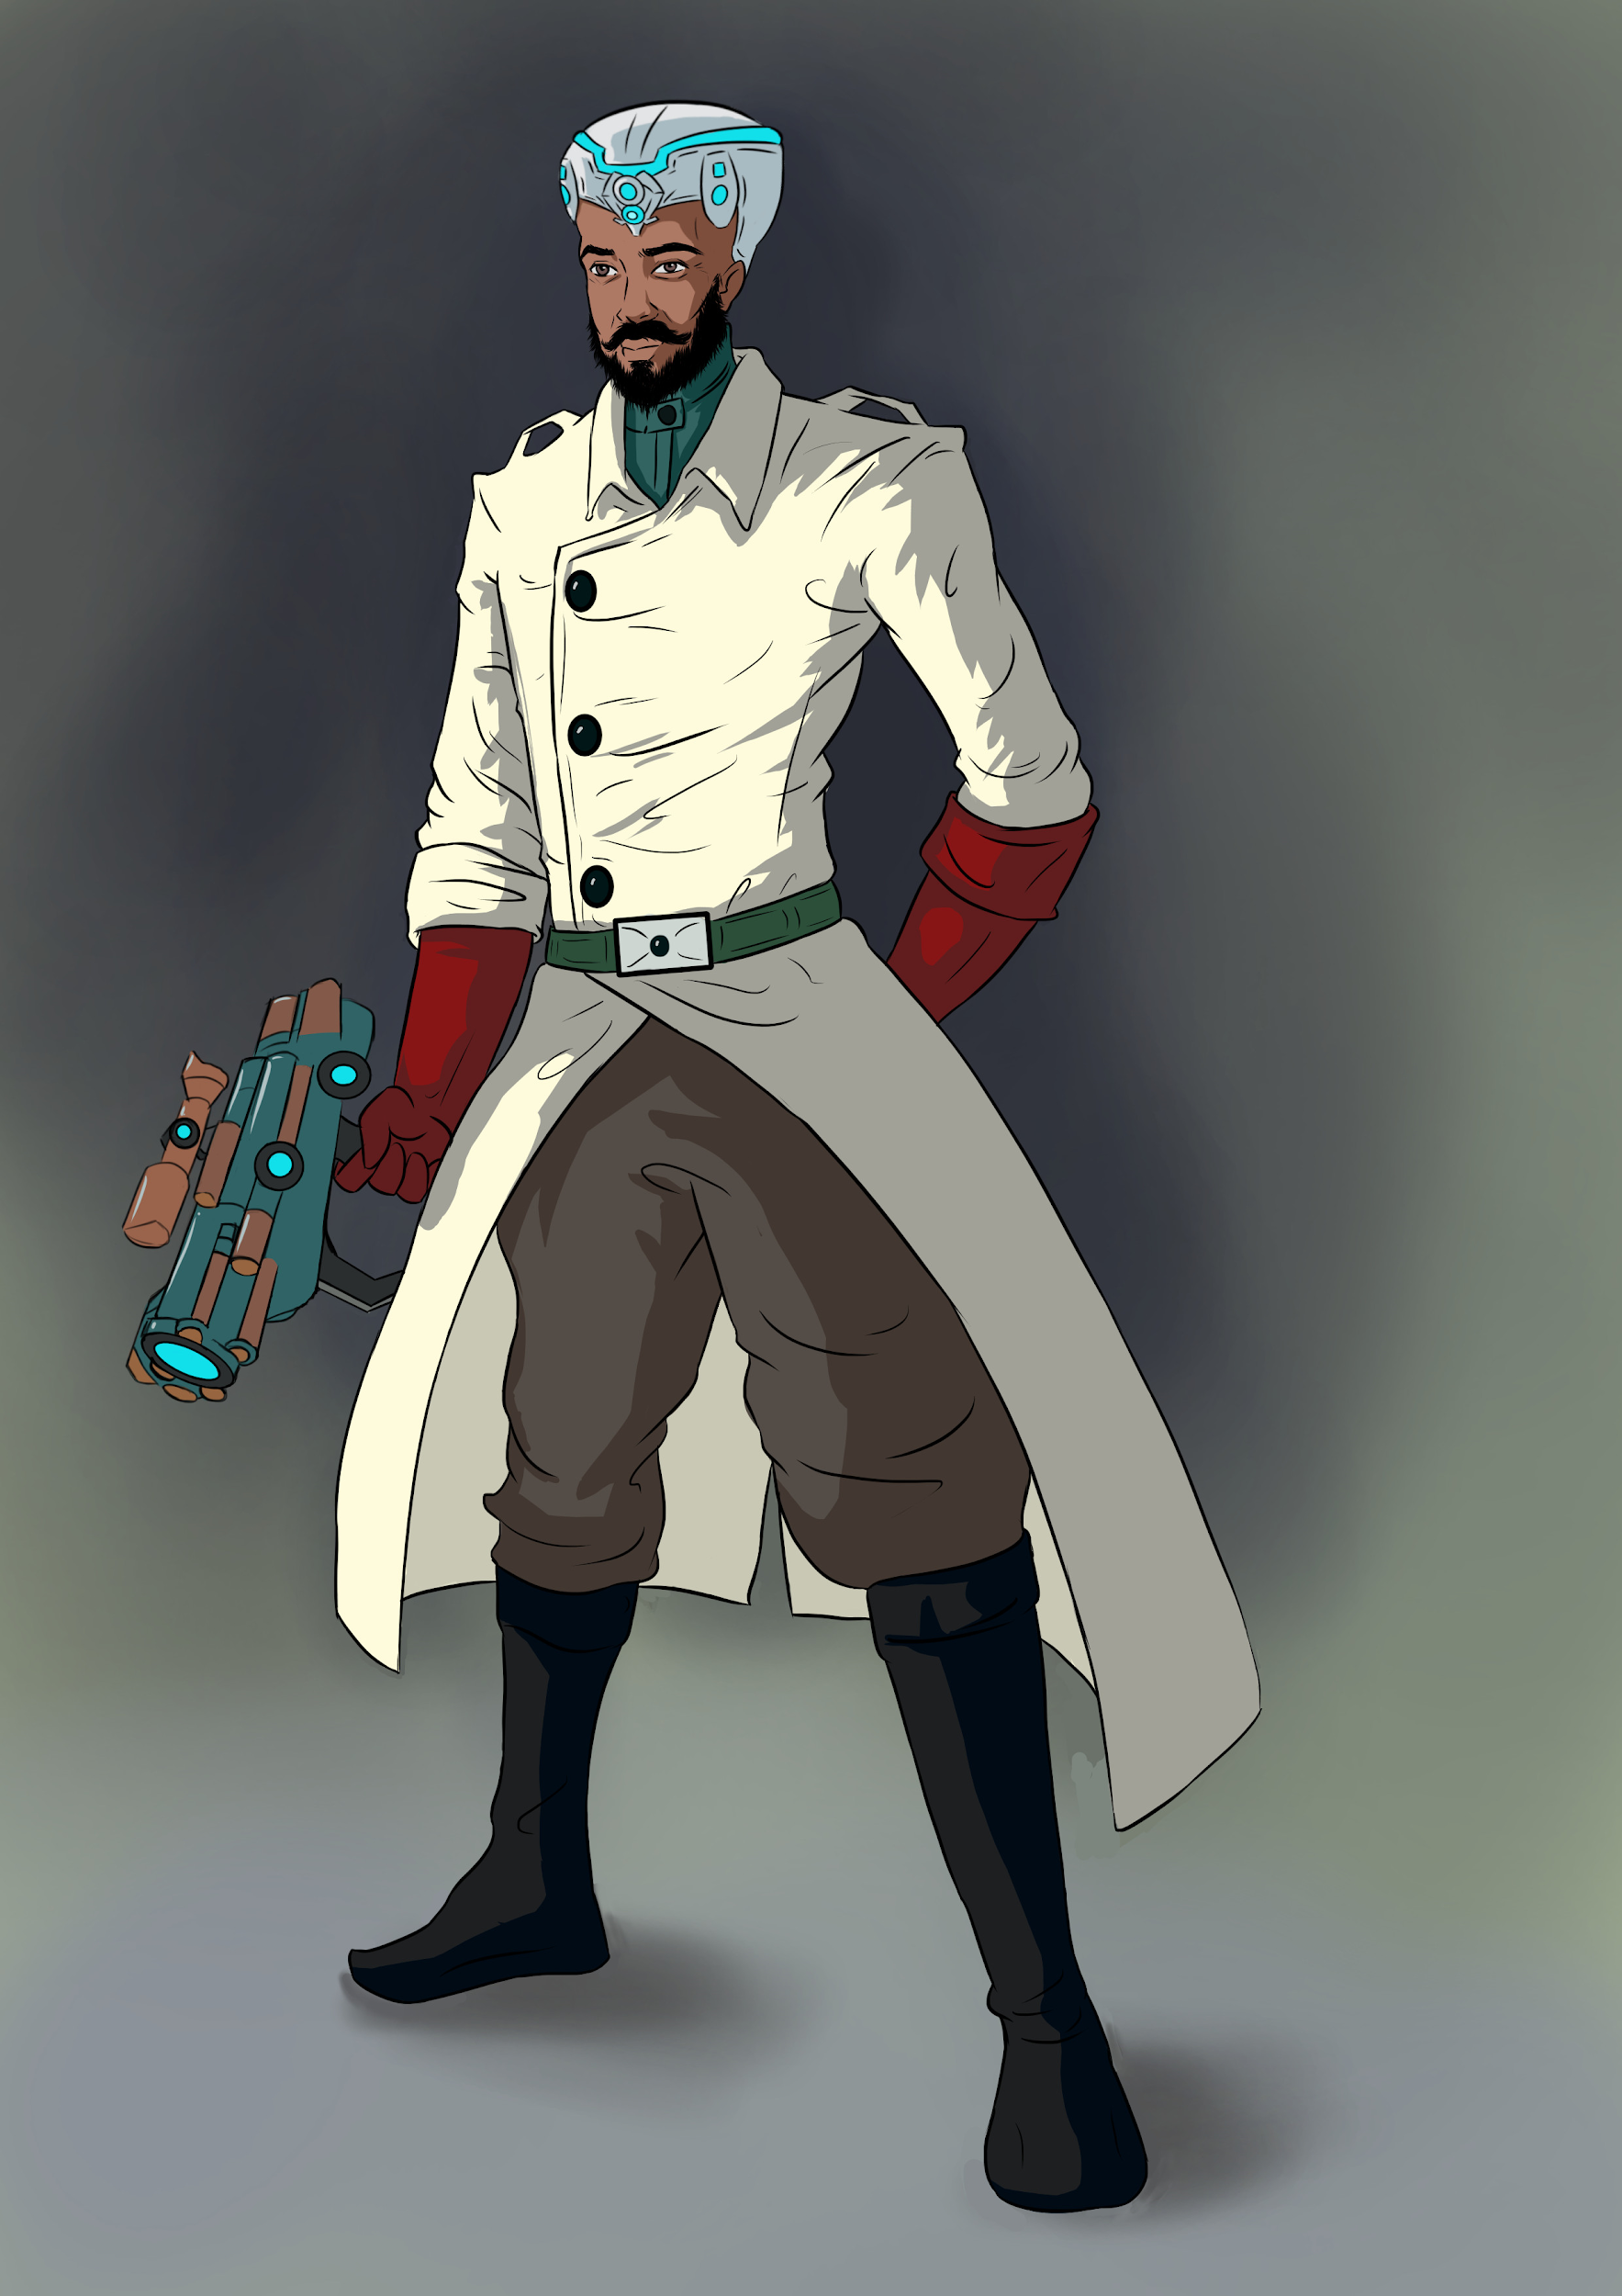
Find us on Teachers Pay Teachers or contact us.
Email us
Our current portfolio of “gamification” based products is on our website and on Teachers Pay Teachers. Visit us at www.gamificationschoolhouse.com
A summary of our portfolio can be found on the following slides.
Please note that while all of the games are designed to be edited or “hacked” to better address almost any emerging needs in the classroom, each game was designed initially to address a specific emerging need. Collaborating with and editing games to meet a teachers specific needs is part of the support.
We can also collaborate with you and your school to design unique game based solutions to a range of school challenges. We have developed a collaboration with a graphic art studio to support such an effort.

Slide 8
Middle school Earth - “The Habbit” - Link
Not a game for students. This games seeks to create a gamification model for teacher Professional Development (PD). The game provides both context and agency for either a 1-5 day start of the year inservice, or it can be easily adapted to a year(s) long gamification system. The core mechanic requires that the teachers are to be divided into groups made up of 4-6 teacher types. This grouping can be based on “goal adjacent” outcomes or diagnostics, school divisions (science, fine arts, language, ect) or other groupings. This allows for horizontal, vertical or special curricular groupings. The game uses and guides teacher through a Design Thinking approach to game design. Game based incentives promote teacher agency in PD. The game acts as both example and incentive.
Gamification superstructure
PD gamification

Slide 9
Attack of the Phlemagotians
Attack of the Phlemagotians was originally created to address the problem of incentivizing formative assessment for student/players. Success with early in class prototypes led to this game superstructure which has been used to address a number of classroom needs. This is the first, and “largest” of the games in the J&P portfolio.
Rich in narrative and world building, student/players create personal superhero avatars that grow in power and prestige as they participate in the game. A teacher “rule book” and separate “backstage” documents are included that explain the function and rationale behind the design and mechanics of the game. What it is to be “heroic”, and Joseph Campbell's “hero’s journey” are addressed.
Gamification superstructure
Can be used to help incentivize: formative assessment, portfolio management, student collaboration, and now creative writing!

Slide 10
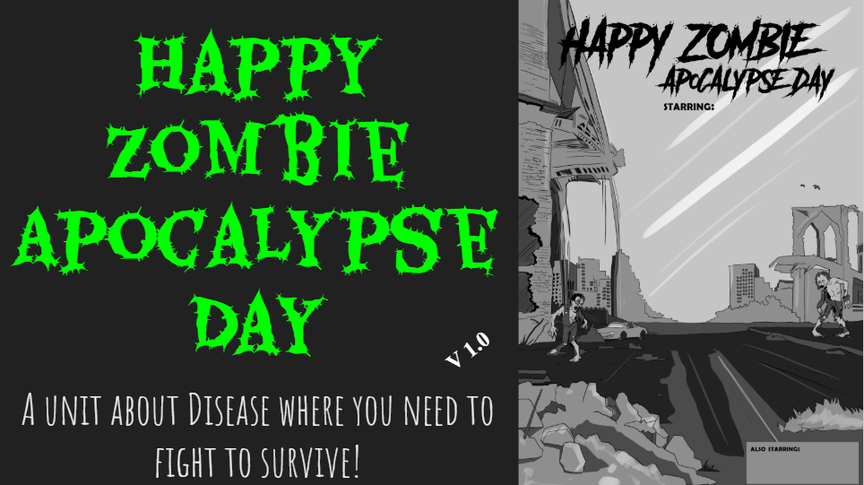
Happy Zombie Apocalypse Day (HZAD)
Happy Zombie Apocalypse Day was originally created to provide a game space in which to approach the problems of differentiation (high and low level), as well as addressing late work in a standards based environment.
HZAD was (and in this published form is) a game superstructure to a [7th grade] science unit on the topic of disease. This product has a series of lessons, activities, and suggested resources that follow a narrative “Survivors Path.” Game mechanics are applied that allowed the teacher to re-incentivize the handing in of work on time, as well as high end differentiation. The game superstructure was adapted at KIS to become the backbone of a 7th grade “total” interdisciplinary unit that continues to this day. Video links to this unit are provided earlier in this presentation.
Gamification superstructure:
Curriculum scaffolding, Differentiation

Slide 11
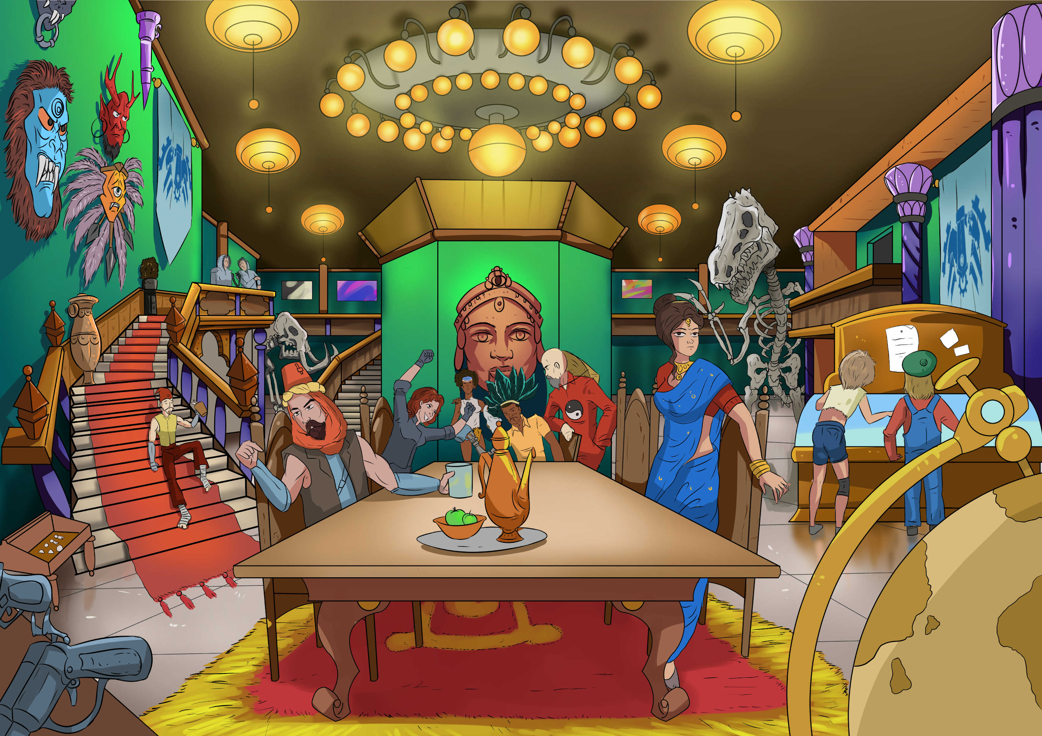
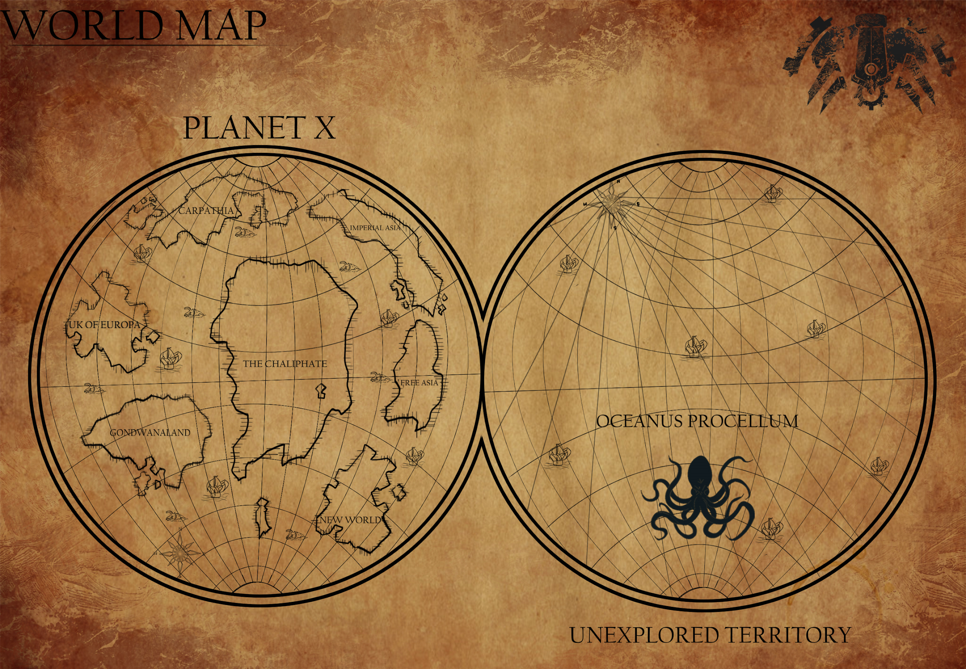
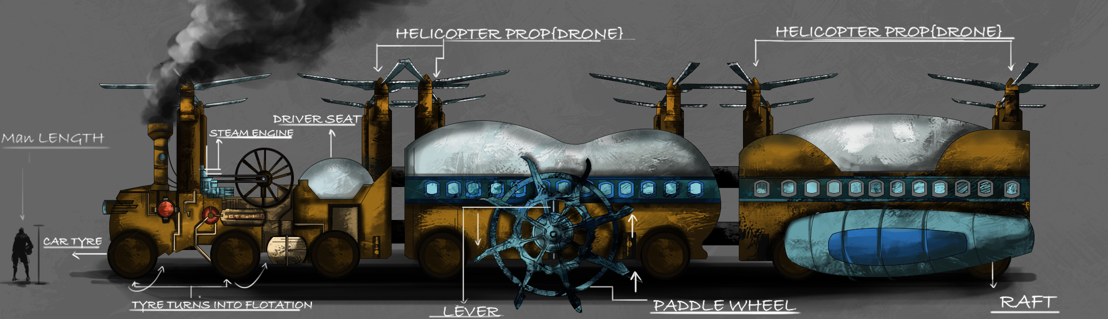
Around The World in 180 Days.
Around The World in 180 Days is the design response to the problem of low student interest in school wide “house cup”, or similar long term competitions in the school.
Traditional school wide competitions usually score with either simple point totals, or a thermometer like graphic. The points have no utility or player agency. 180 Days is a steampunk themed game mechanic that allows student/players at different grade levels, but in the same “house”, to make game decisions that will affect the entire teams overall game performance. During the school year houses will be given the opportunity to use some of the points their house have earned to navigate a steampunk world that will be both familiar and totally new.
Gamification superstructure
Within school team competition game support.

Slide 12
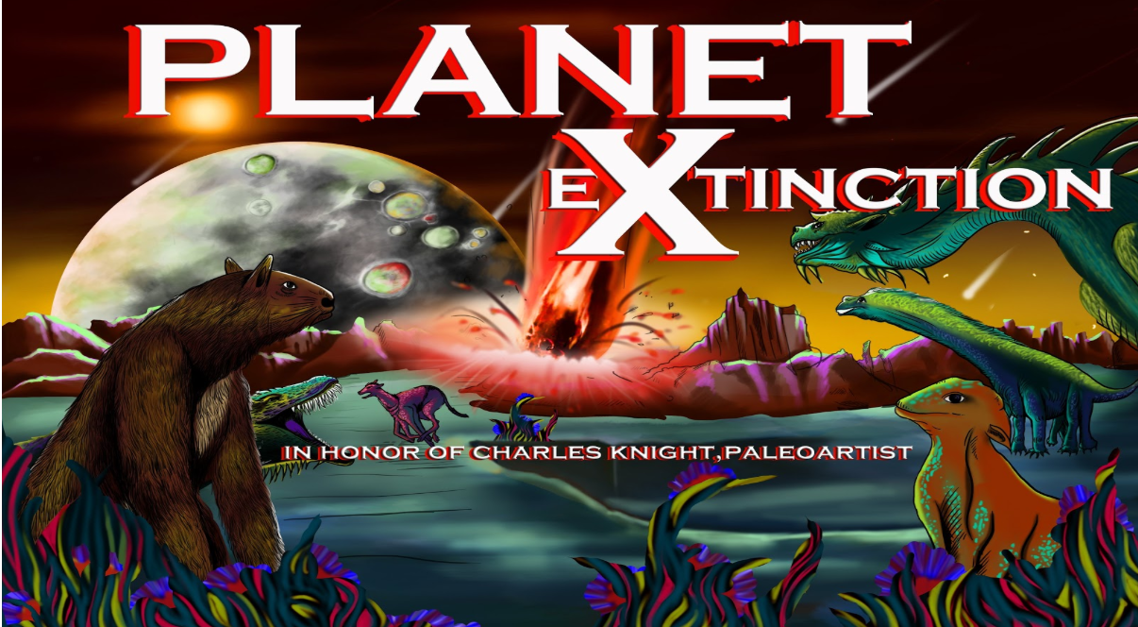
Planet eXtinction
Planet eXtinction was originally created as a follow up to Happy Zombie Apocalypse Day. Given the immediate success we had with HZAD we started designing the next game. Planet eXtinction sought to once again provide an alternate classroom economy for differentiation and incentivising academic adjacent behaviors. Additionally we used this game to introduce content and standards on the topic of evolution.
This version will benefit from a later adaptation of the original model to provide an authentic in science opportunity to introduce and incentivize descriptive additional writing and language development when this game was then used in an ESL setting.
Gamification superstructure
Content Instruction, Descriptive writing

Slide 13
“On the Mating of Dragons”
On the Mating of Dragons is an internationally themed genetics simulation lab that honors many of the cultures from which these mythic flying creatures are sometimes drawn. Major differences between so called “Eastern” and “Western” dragons are captured in this lab. Because this is a fictional creature, examples of codominance, incomplete dominance, epistasis, sex linked traits, and a genetic disease could all be included in the simulation.
If you have the time this lab also allows for the integration of a STEAM art opportunity, a descriptive writing opportunity, and some cross curricular integration opportunities.
Genetics Lab-
Though not a game, it uses world building and narrative in much the same way a game does

Slide 14
Tome Raider
Tome Raider was the design response to a request from a colleague who wanted to lead a book discussion on Lord of the Flies. Because that book had a social ostracism theme that I was uncomfortable with, the evolving design solution sought a more generic way to add agency and some “game fun” to the discussion of almost any novel. The result was Tome Raider
Tome Raider is strictly a game mechanic. The teacher/user will have to create “Character” and “Crossroad Event” cards based on the narrative of the specific book being discussed. Once created these can be reused for multiple sections, and for reuse the following year.
Gamification mechanic
Book Discussion with Critical Thinking

Slide 15
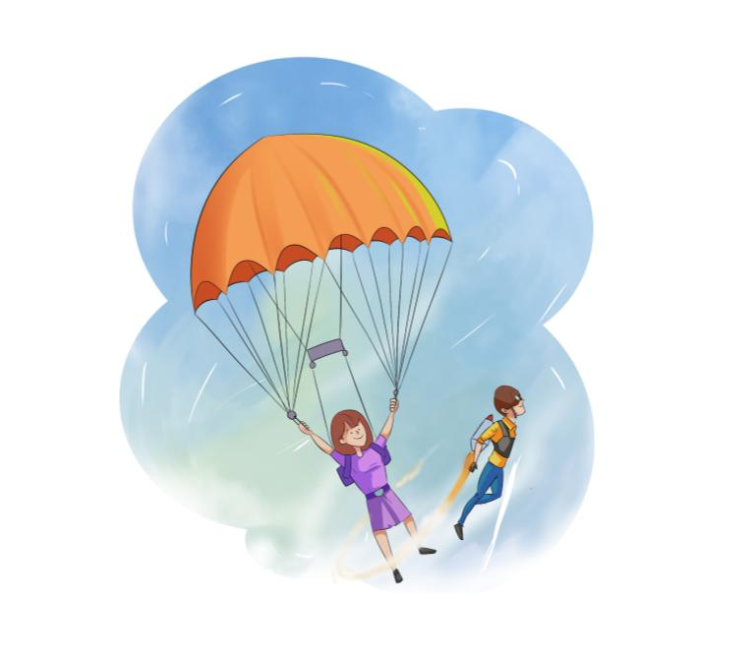
Gamification Schoolhouse Support Videos
These videos will;
Provide basic support for describing what gamification is and how it works in education
Provide real examples of how gamification has addressed classroom challenges
Provide support for the gamification products we offer
Share games and gameplay that can be used by teachers (dailey mental play “break”)

Slide 16
Breakout Room Design
Some game like experiences can only be designed if certain information is known. A Breakout Room is one example. Even generic kits do not always help because designing for 12 student/players is very different than for 24. Without knowing things like duration, number and age of students/players, and lock specifics to name but a few I have not figured out how to provide a generic mechanic here.
However, we have had multiple experiences (ask us about them) designing escape rooms for both students and groups of teachers. Please contact us for details on how we might collaborate with you on the design of your own Breakout Room with a theme you select.

Slide 17
Gamification could solve or mitigate a great deal of institutional stress if applied well to education.
Quotes from Jane McGonigal. Author, Speaker, and foremost authority on “Gamification”.
There is no problem that doesn't have some underlying need for more optimism, stamina, resilience and collaboration. And games are, I believe, the best platform we have for providing that.
When we play games, our brains respond differently to stress and obstacles. We're better able to control our attention and ignore distractions.
I want gaming to be something that everybody does, because they understand that games can be a real solution to problems and a real source of happiness. I want games to be something everybody learns how to design and develop, because they understand that games are a real platform for change and getting things done. And I want families, schools, companies, industries, cities, countries, and the whole world to come together to play them, because we’re finally making games that tackle real dilemmas and improve real lives.

