Slide 1
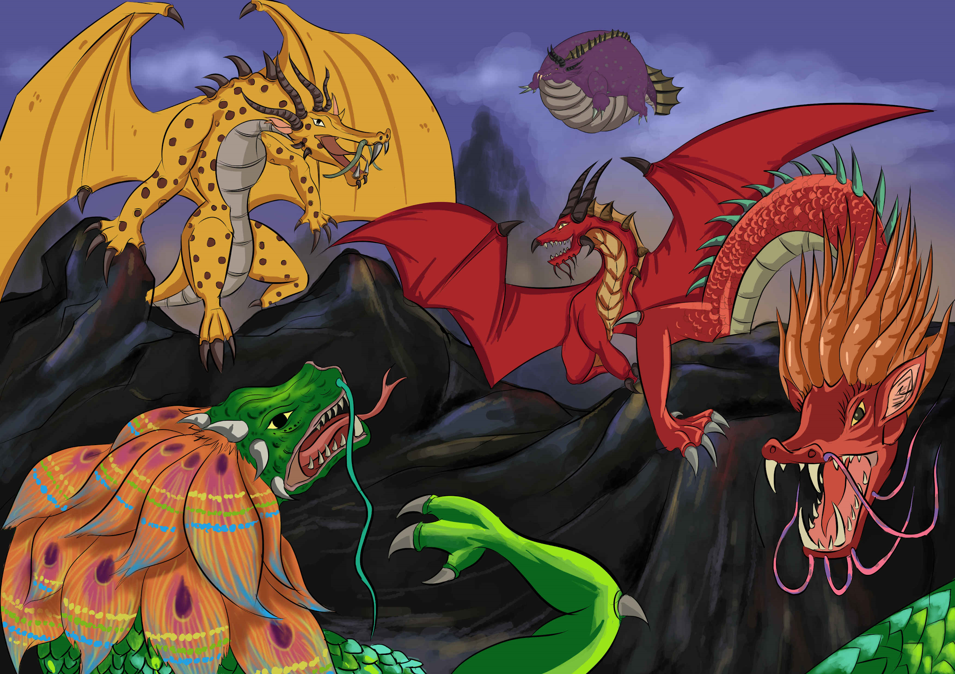
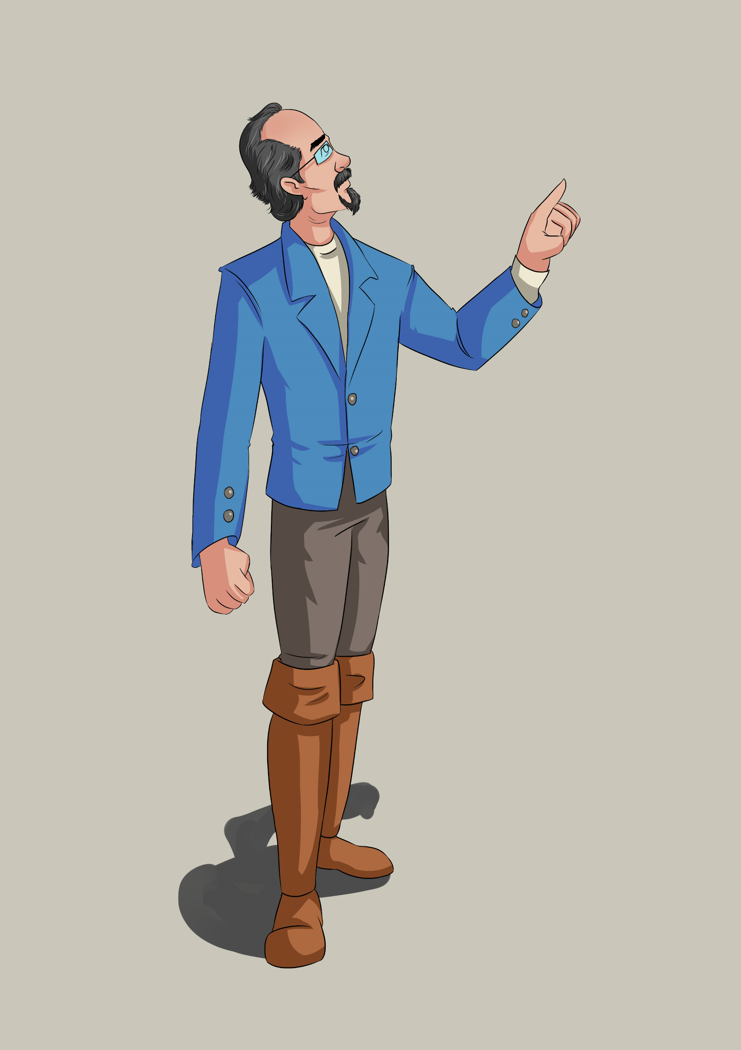
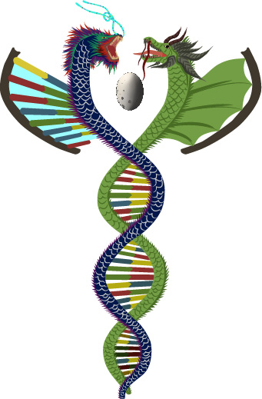
“On the Mating of Dragons”
©
An International Dragon Genetics Lab
Designed a

Slide 2
“On the Mating of Dragons”
Version 1.2| Copyright 2016-2020
A Gamification Schoolhouse creation
©
An International Dragon Genetics Lab
Designed and written by Eric Nelson
Edited by Forrest Brinker & Julie Facine
Artwork by Hephaestus Entertainment

Slide 3
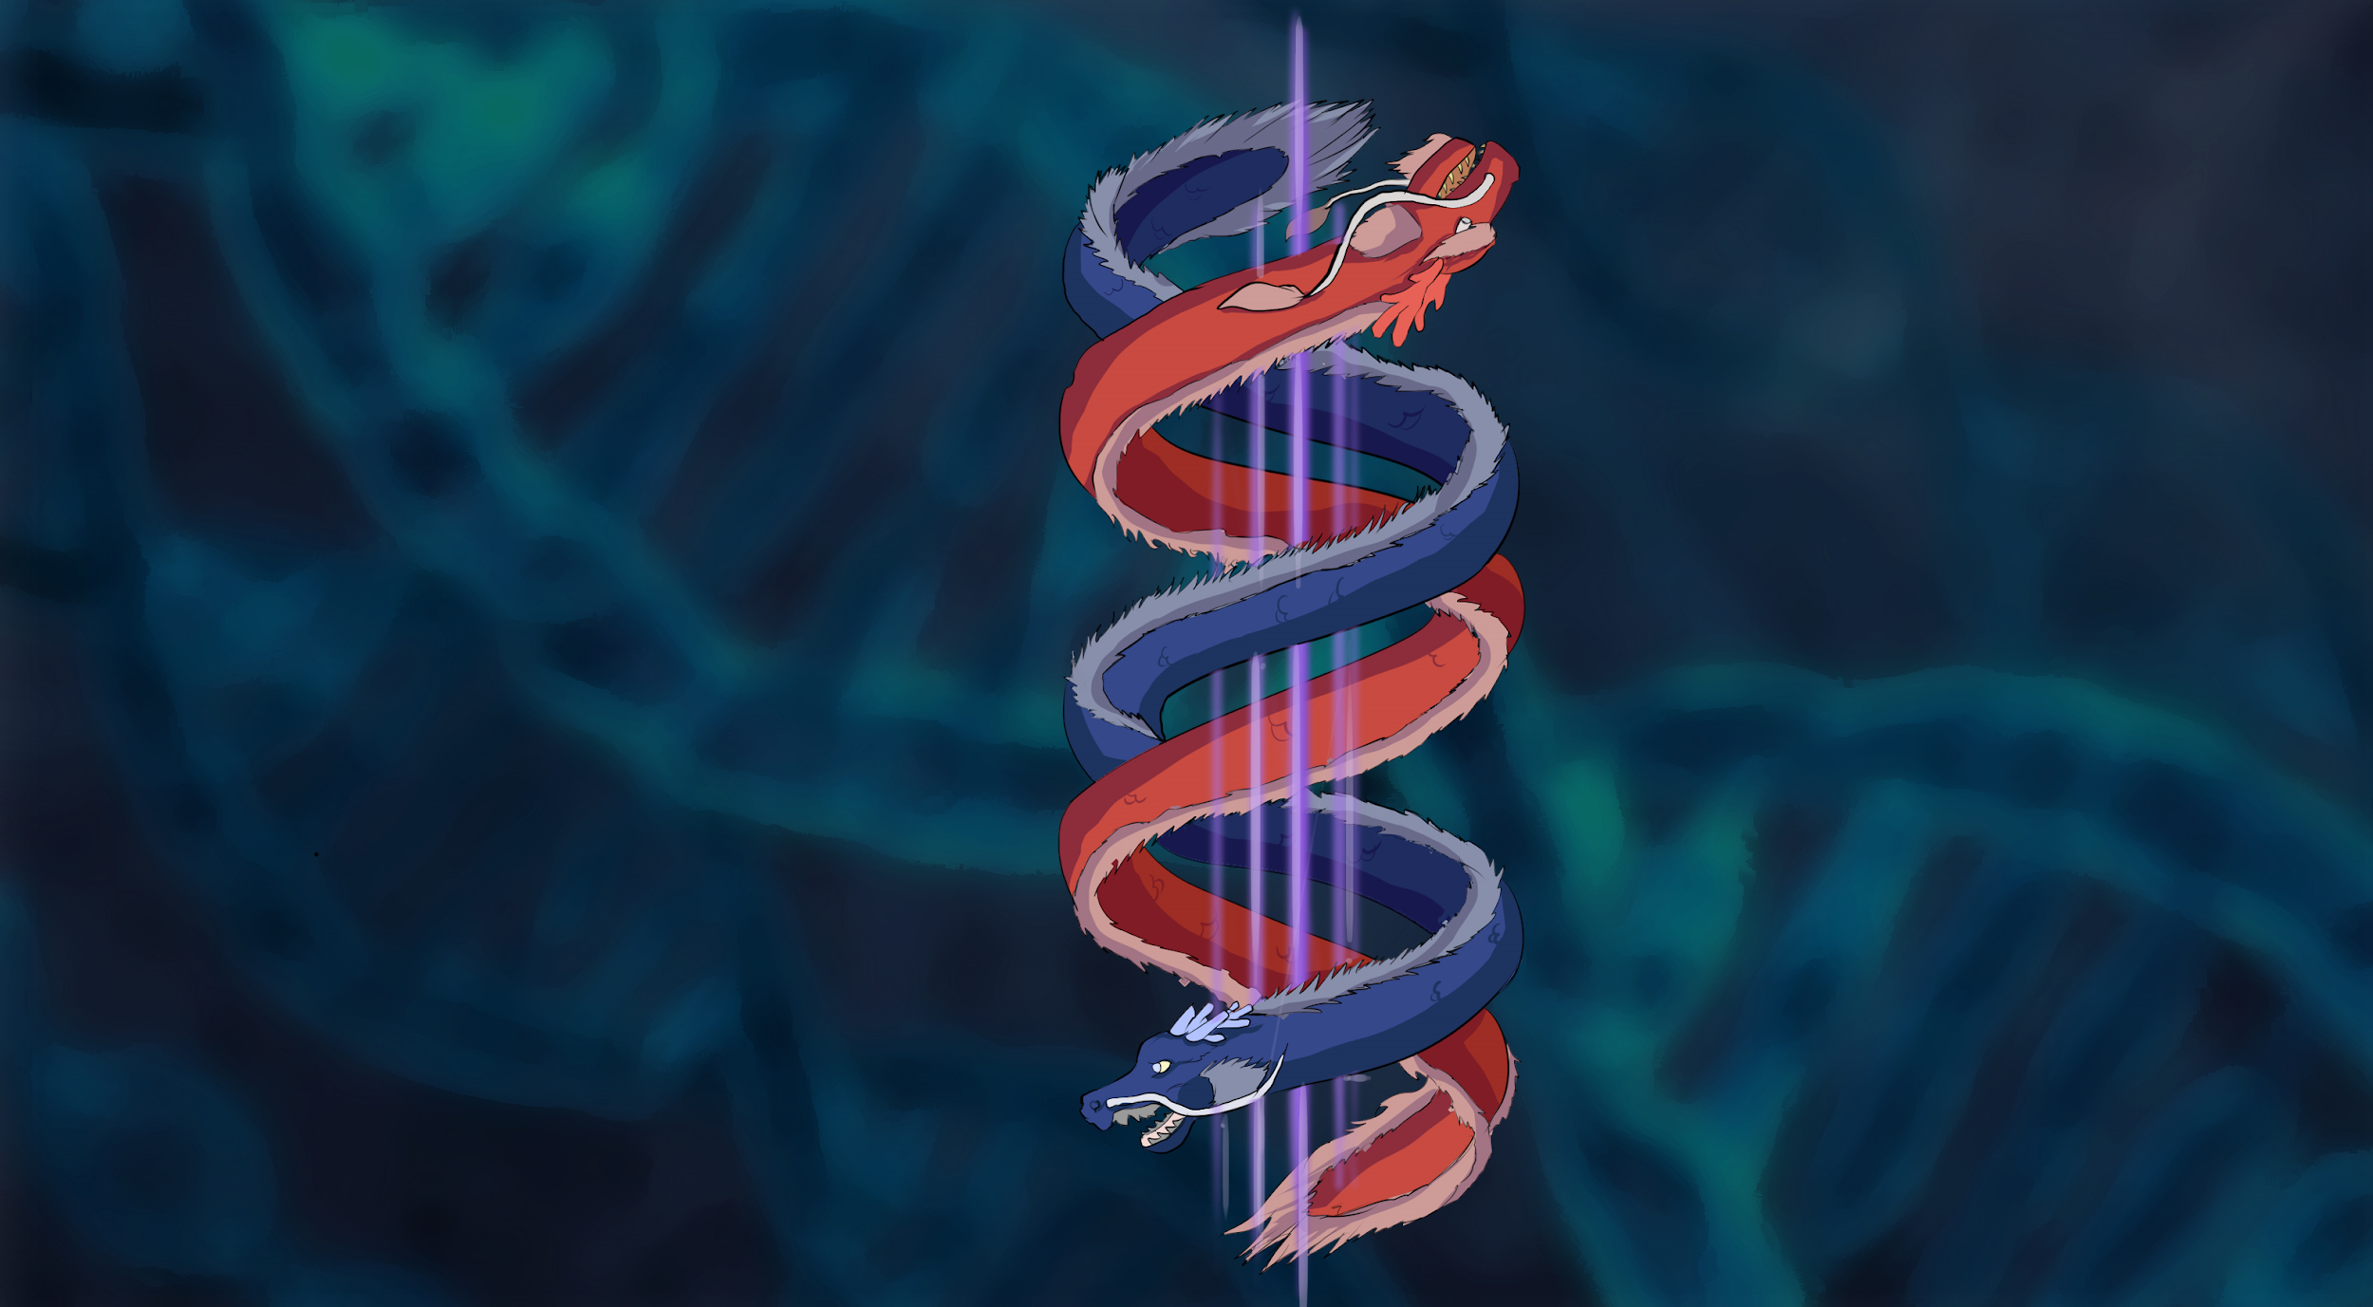
Introduction
Welcome to Dragon Genetics!
In this activity you will learn the science of heredity and genetics through the breeding of fictional organisms - DRAGONS!
You will demonstrate your understanding of the science of genetics when you:
Create diploid chromosomes and use them in two separate simulated meiosis events to create and combine sex-cells
Compare your grandbaby dragon (F2) to its four grandparent dragons

Slide 4
Part 1- An Introduction to Planet XY Biology
Bad Science ALERT- Critical thinking required!
Fiction: invention or fabrication as opposed to fact.
synonyms:fabrication, invention, lies, fibs, untruth, falsehood, fantasy, nonsense
"The work Alice in Wonderland is fiction"
DRAGON GENETICS is set on Planet XY. This is because Dragons are more interesting to most students than pea plants or fruit flies. This lab will use little lies about dragons to tell big truths about how the basics (and a bit more) of genetics dictate heredity.
You will be aided in understanding of the pseudoscience of dragon biology by the writings of the Planet XY explorer Sir Deric Attenborough Nelson (no relation).
So. Genetics = science FACT
Dragons, and related dragon traits = fiction

Slide 5
The world and humans of Planet XY
This lab is set on “Planet XY”. Planet XY is very similar to our Earth. It has the same geologic history as planet Earth, so the continents look the same as Earth. The only difference is the evolution of Dragons. Planet XY also evolved humans. Humans DO NOT hunt dragons. Dragons, like humans, come in different shapes and sizes. Different kinds of dragons can interbreed. Each of the 17 dragons listed here are considered to be subspecies or breed of one another. In his notes, Sir Deric Nelson introduces dragon language as an isolating mechanism between “subspecies.”
Because dragons and humans are both dominant and intelligent creatures, Planet XY has evolved socially in a way that is slightly different to Earth. Dragons traditionally like the ecosystem they evolved in. A tropical forest based dragon has NO interest in invading and taking over any territory they are not adapted for. Human armies, from an area occupied by a different subspecies of dragon would be unwelcome by another subspecies. As a result, Planet XY has never had large scale wars!
War sometimes leads to technological advancement. As a result, Planet XY has technology equal to that of Europe in the 1800s on Earth. However, the colonial dominance of Western countries such as Britain, Spain, France, the US, and others never occurred. The nations of Earth do not exist as we understand them on Planet XY. With the advent of steam technology humans have started to travel across Planet XY. The dragon subspecies on Planet XY might now start interbreeding. Sir Deric now wonders what might this look like......

Slide 6
“On the Speech of Dragons”
The dragon language has long been a mystery to most humans. This is a shame as the ability for dragons to engage in human speech is limited in most populations. Observations of populations where the ability to engage in human speech is “in question” indicates that the gene for speech is recessive. Historically it was believed in some cultures that the ability to breath fire dictated and prevented the ability to speak to humans. The data indicates that the ability to breath fire seems completely independent of the ability to speak human. In fact it goes a long way to explain why, when speaking to a fire breathing dragon, one tends to mind one's manners.
Dragons have a unique language that relies on deep chest thrumming in addition to vocalizations. Though the collective work of dragon enthusiasts from around the globe, including myself, we have confirmed that some important and variable elements of dragon communication depend on frequencies too low for the human ear to hear. As our ability to sample these frequencies improves, so will our understanding of the dialects of dragon we see today.
Some dragon types, most notably Long Wan Die, Quetzalcoatlus, Saxon Red, and the Zulu all developed methods to communicate more clearly with humans if a dragon lacked the ability to “speak human”. The “Dragon Stylus” used by the Long Wan Die even allows dragons to explore an interest in “dragon poetry”, an admittedly acquired taste in literature for most humans
Why is it important that Sir Deric look at populations where the ability to speak human is “in question” in order to tell if a trait is recessive?

Slide 7
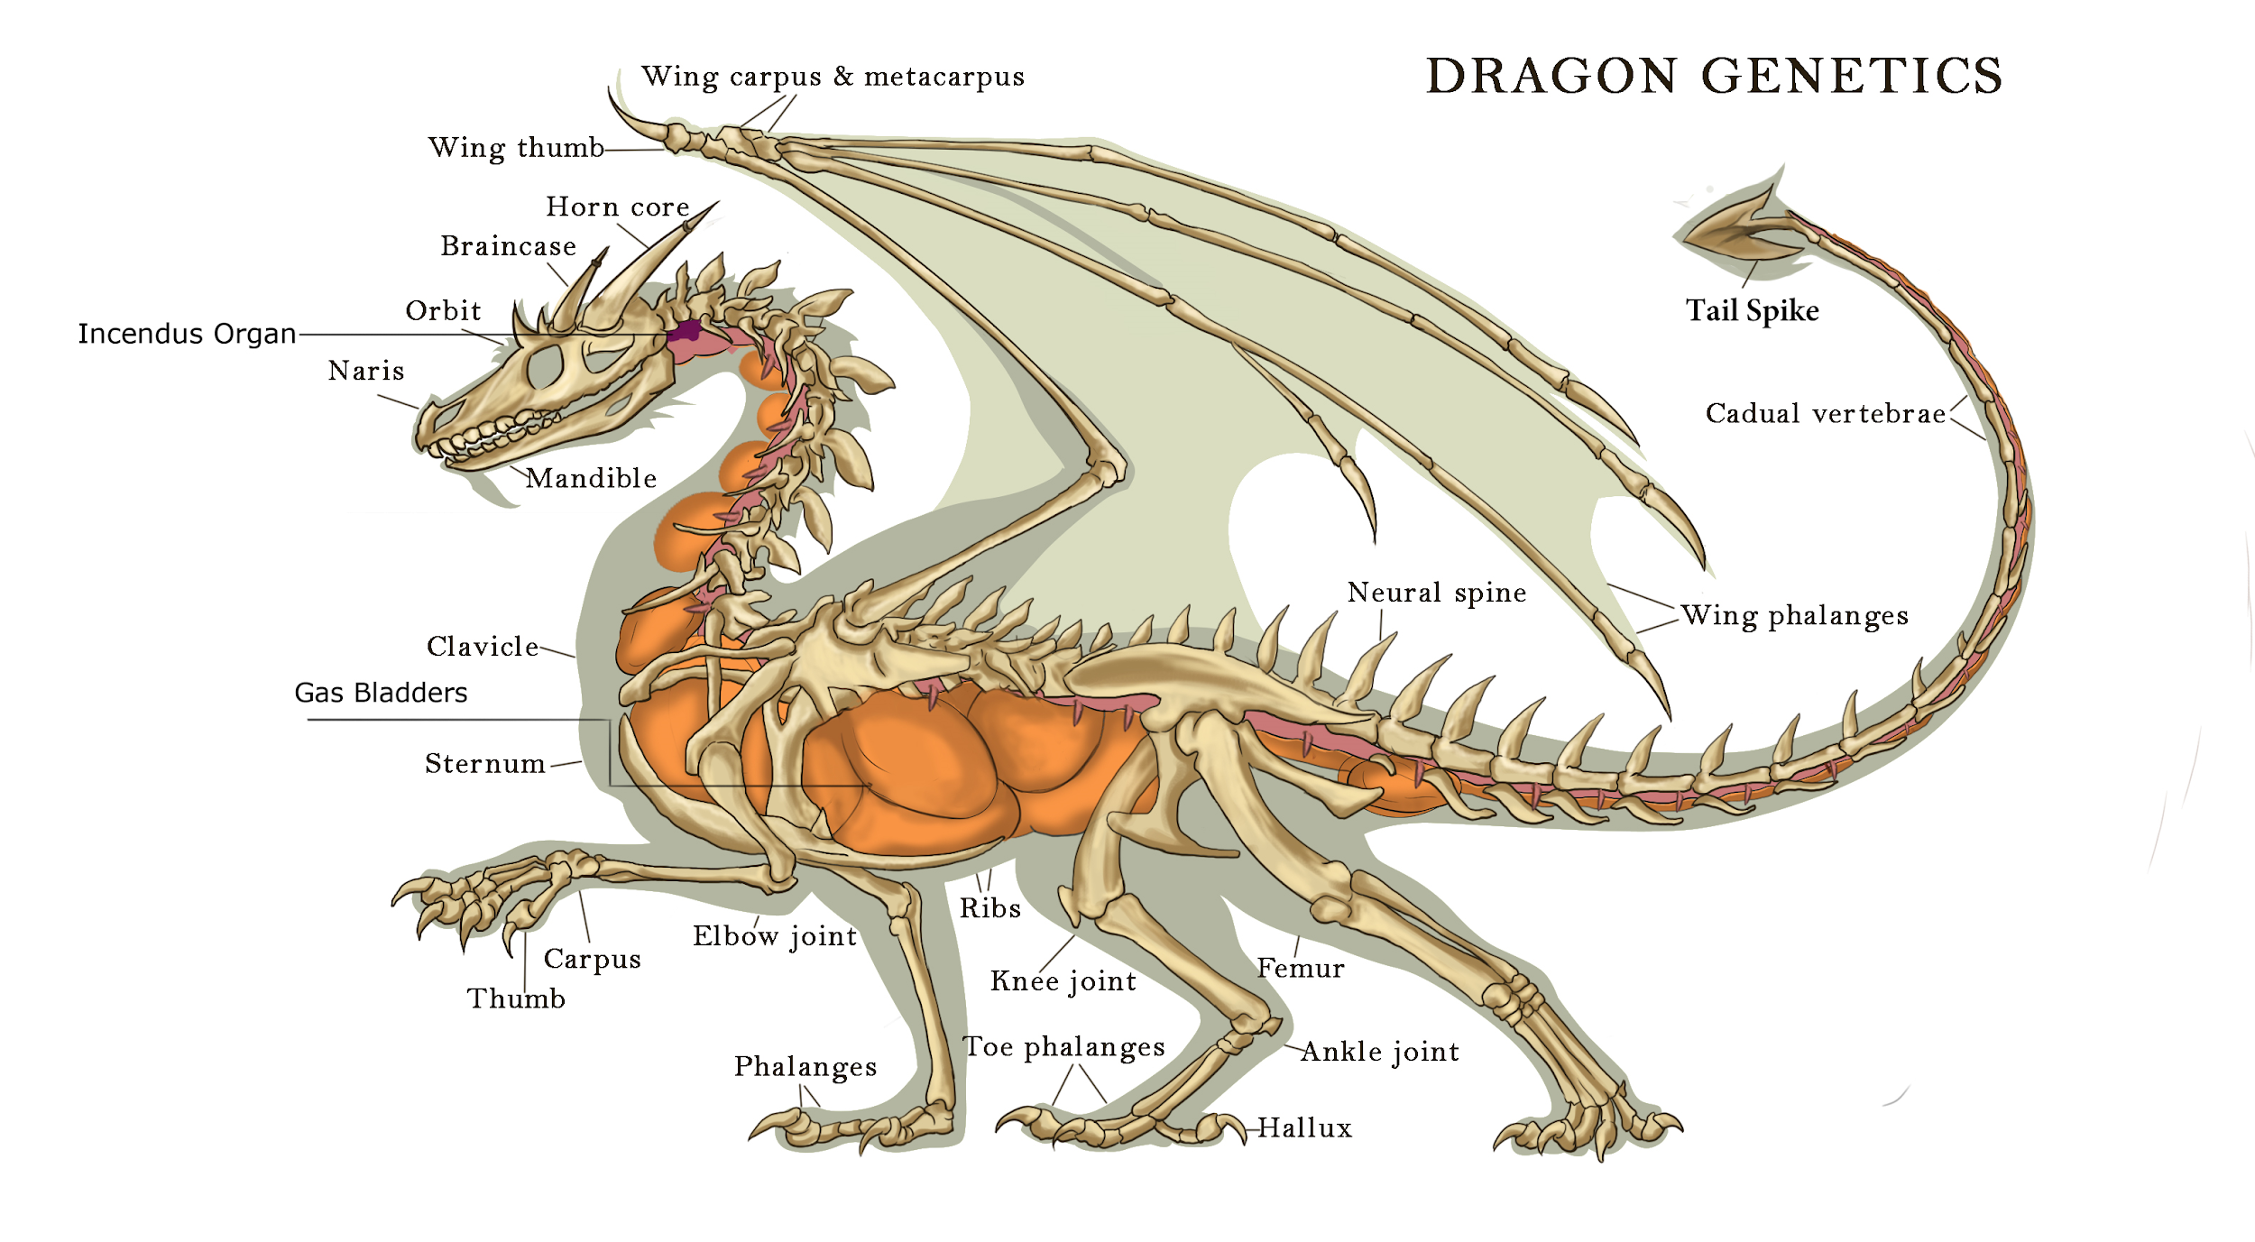
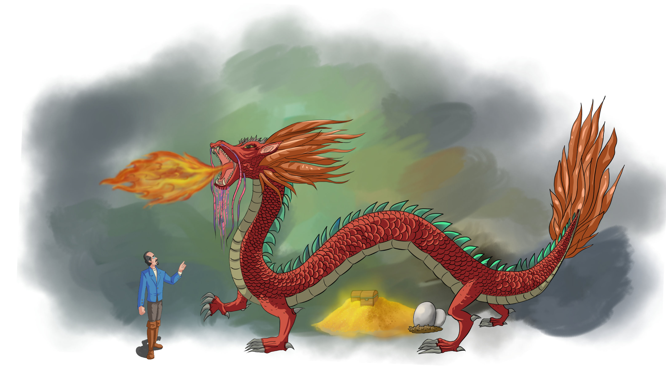
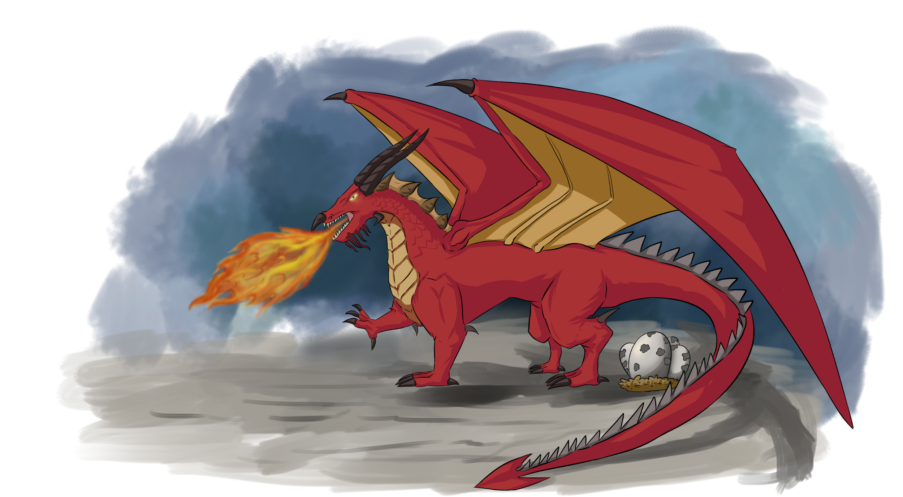
Basics of dragon biology- by Sir Deric Attenborough Nelson
On Planet Earth all terrestrial vertebrates are descended from tetrapods. This means they had 4 limbs. For birds and bats the front legs became wings, and for humans the front legs became arms. On Planet XY, dragons are hexapods. They have 6 limbs; 4 legs and two wings. On Planet XY even the “wingless” dragons are hexapods as the wings do not disappear, rather they fuse to the body creating two long gas bags along the back.
Wingless dragons tend to have less robust rear legs and a more “serpentine” body than a winged dragon.

Slide 8
How wingless dragons fly
on Planet X?
Big creatures are heavy. On Planet X, dragons have evolved an organ that can create and store hydrogen, a very light gas. This gas can be pumped into large areas of spongy tissue throughout the body. Wings help the dragons to better swim through the air, but all dragons can fly. The Polynesian Windsurfer (see dragons listed on the following slides) can actually inflate itself into a large balloon and float for long distances over the Pacific ocean. Some of this gas is moved to the “Incendus organ.” Fire breathing is not well understood as the Incendus organ starts to decay within minutes of a dragon’s death.

Slide 9
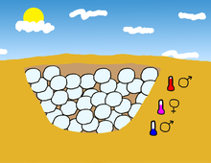
Boy Dragon / Girl Dragon ???
During our 2 breeding sessions during this lab, we could randomly produce too many boy or girl dragon eggs to make dating in the next generation balanced.
So…..
Dragons, like some other animals, can change genders depending on environmental conditions. To ensure that there is an even number of males and females in the lab each mating flight will produce only 2 eggs. The second egg is always the opposite gender of that of the first egg.
Earth Example.
Sea Turtle sex determination is based on temperature.
Link to a TED Ed video on Sex Determination.
https://www.youtube.com/watch?v=kMWxuF9YW38

Slide 10
Part 2 - The Genetics of Dragons
In this lab “On The Mating of Dragons” you will be simulating the production of haploid (n) sex cells (with half the DNA of the parent) and then combining this sex cell with the sex cell from another dragon to create a new fertilized egg or zygote(2n).
Remember that a gene represents a segment of DNA that codes for heritable traits in the form of proteins made by following the instructions found on DNA. These genes occur in Homologous pairs (2n).

Slide 11
How to Hatch a Dragon Egg
You will be given a dragon egg with a list of genotypes [Tt] = 2n. Different versions of the same gene are referred to as different alleles of the same trait. This presentation will explain the various genotypes (the 2 alleles) and how they are expressed as phenotypes (what you see) for each trait.
Most of the genes in the lab will occur in Homologous pairs. This means they will each be located in the same location on both (2n) chromosomes. Some sex linked traits and/or feathers may have only 1 copy of a gene.

Slide 12
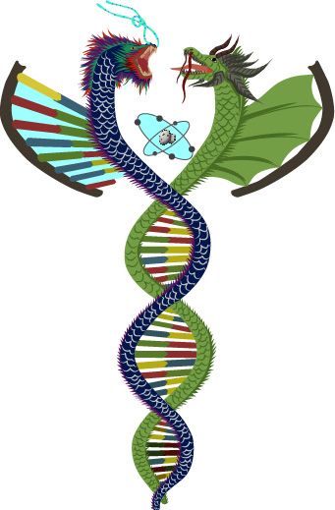
Trait List
Sir Deric has been able to identify 18 traits and 1 regulatory gene on a total of 5 chromosomes. Sir Deric used the following lettering for his alleles. You may use it at your discretion. Notice the frequency of “T” if you are doing dihybrid crosses.
Sex Chromosome
X/Y- Gender
[X,Y]
Endurance 1
[E₁,e₁]
Endurance 2
X only- [E₂,e₂]
Jeweled eyes
X only- [J,j]
Chromosome 1
Color 1
[R,r]
Color Control
[C,c]
Toe Number
[T₁, t₁]
Treasure Lust
[T₂, t₂]
Chromosome 2
Color 2
[G,g]
Color Pattern
[C1,C2]
Horn
[H,h]
Spines
[S,s]
Chromosome 3
Wings
[W,w]
Neck length
[L,l]
Tail Spike/ball
[T,t]
Feathers
[F,f,none]
Chromosome 4
Eggshell Color
[G,W]
“Fire breathing”
[F,f]
Tendrils
[T,t]
Speak Human
[S, s]

Slide 13
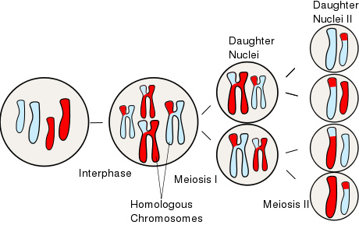
Making Your Dragon’s Chromosomes- part 1
Remember that the purpose of Meiosis (as opposed to Mitosis) is to create a haploid (n) sex cell from a diploid (2n) cell. Your cells (2n) have one set of information from your Dad (n- the red chromosome), and one set from your Mom (n- the white chromosome).
Notice that the genetic information you put into your cells can come from Dad, Mom, or a combination of both. This is because genes on homologous chromosomes can switch positions. This is called “crossing over” and is why in this lab you will flip your “2n popsicle” stick for each gene on the chromosome.

Slide 14
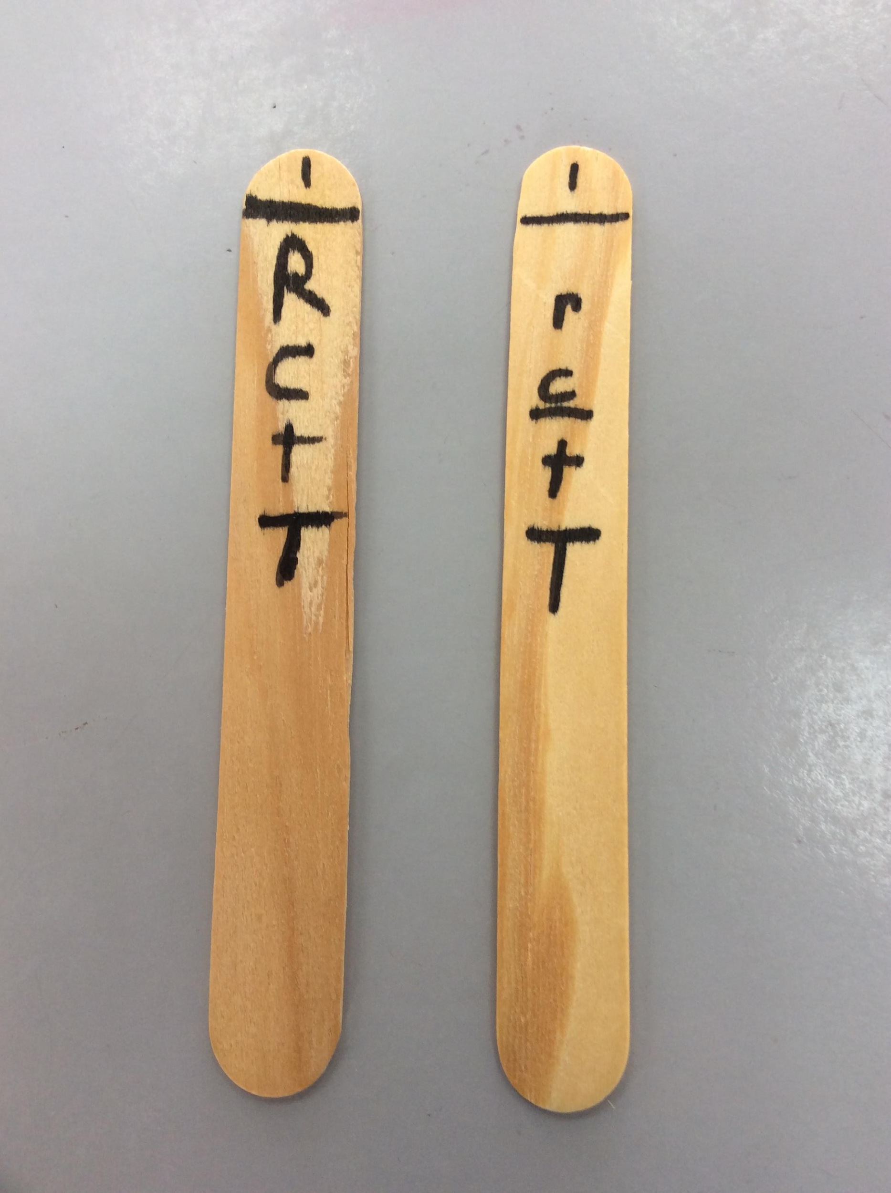
Making Your Dragon’s Chromosomes- Part 2
How to use your sticks - Video
For 3 of your dragons you will need to make 5 “Chromosomes” out of Popsicle sticks.
Step 1- Get 5 popsicle sticks and look at the slide Labeled “Trait List”.
Step 2- Number the five sticks 1, 2 ,3 ,4 , X/Y at the top.
Step 3- On one side place the first letter of each genotype {for example: Chromosome 1- Color 1 if you were heterozygous for Red [Rr] you would place an “R” on one side of the stick and a “r” in the same place on the reverse side of the stick}
Step 4- Repeat on the same stick for the Color Control, Toe Number, & Treasure Lust genes. Be careful with case!
Step 5- Repeat steps 1-4 for the next 4 sticks. Remember, males will have 2 fewer genes on the “Y” stick
Chromosome 1
Color 1
Heterozygous
Color Control
Heterozygous
Toe Number
Homozygous Recessive
Treasure Lust
Homozygous Dominant
Side 1 Side 2
Notes:
Please remind student to be clear with upper and lower case.

Slide 15
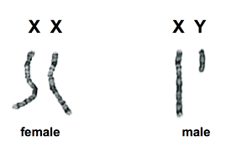
Your Dragon’s Chromosomes-
Part 3 That Weird Sex Chromosome
Sex Chromosome
X/Y
Entire Chromosome dictates this “Trait”
Both parents flip
Endurance 1
Heterozygous
Both parents flip
Endurance 2
Found only on X
Only mother flips
Jeweled Eye
Found only on X
Only mother flips
Yes, sex chromosomes complicate this simulation, but including it allows us to look at their effects on more than just gender. Because the “Y” chromosome is smaller than the homologous “X” chromosome it contains less information.
IMPLICATION
If you are the father you will flip the sex chromosome only 2 times if it starts “Y”. Once for gender and once for “Endurance 1”
If the child is given a “Y” by the father- give nothing for last two genes
If the child is given a “X” by the father- give the genes found on the father’s “X” {E, J}
NO GENE
Example Male Chromosome

Slide 16
Mendel's Laws of Genetics
1) The Law of Segregation: Each inherited trait is defined by a gene pair. Parental genes are randomly separated to the sex cells so that sex cells contain only one gene of the pair. Offspring therefore inherit one genetic allele from each parent when sex cells unite in fertilization.
2) The Law of Independent Assortment: Genes for different traits are sorted separately from one another so that the inheritance of one trait is not dependent on the inheritance of another.
3) The Law of Dominance: An organism with alternate forms of a gene will express the form that is dominant.

Slide 17
Dragon Traits
In this simulation, there are 18 traits controlled by 20 genes as identified by Sir Deric Nelson. Inspired by the work of Gregor Mendel (yes there is one on Planet XY), Sir Deric wishes to predict the possible progeny from 2 dragons of different subspecies using these laws.
There are however a number of “secondary traits” that Sir Deric has not been able to identify the genetics behind. The actual shape of a tail spike, wing, horn, spine, tendril or any other notable feature could exhibit new and novel combinations. Only the core traits are fixed in Sir Deric’s notebook. Feel free to create hybrid secondary features if you are drawing your baby dragons.

Slide 18
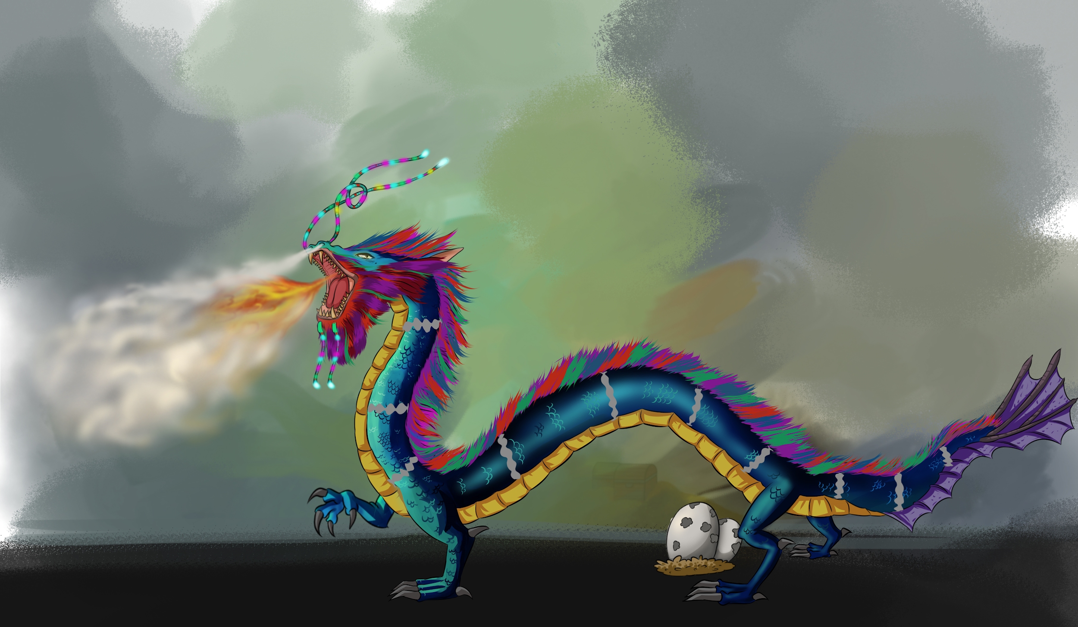
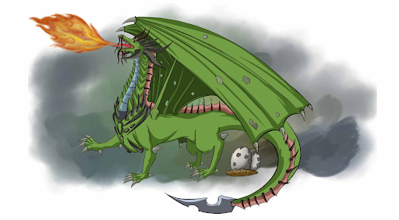
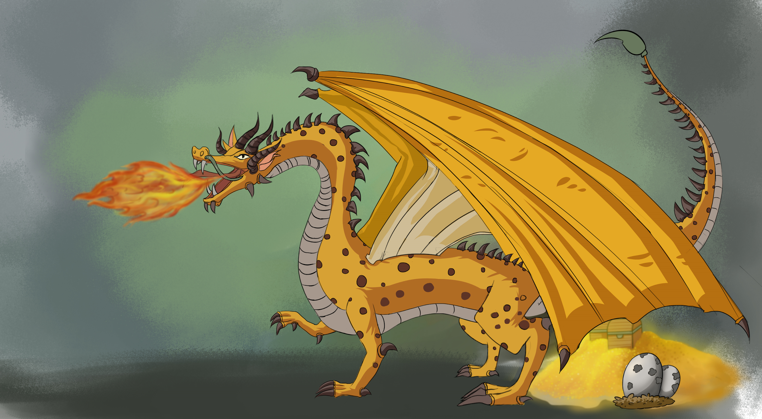
Color Control Gene- Operator genes
Trait
Some genes do not code for a trait. Instead they control if, when, and/or for how long other genes are turned on. These are called operator genes
In dragon genetics there are 4 primary colors with Red/Blue on one gene and Green/Yellow on another. The expression of the R/B gene is dominant over the expression of the G/Y gene.
[CC, Cc] = use Color Gene #1,
[cc] = use Color Gene #2
Color Gene 2
Color Gene 1

Slide 19
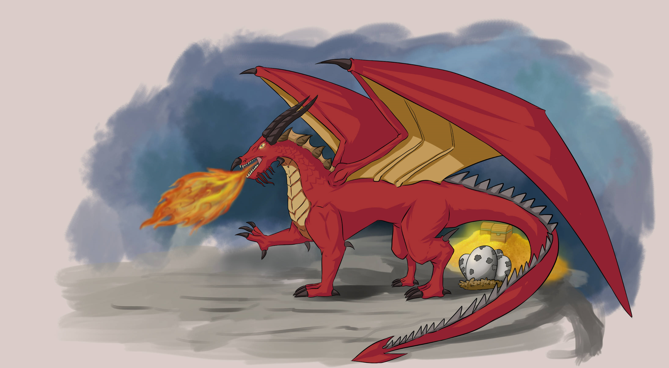
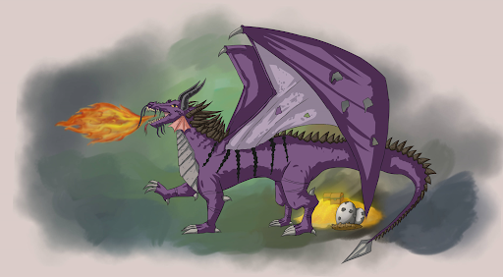
Color Gene #1- Mendelian & Incomplete *Sex Linked
Trait
In Females [XX]
Red [RR, Rr] is Dominant over
Blue [rr].
In Males [XY]
Red [RR] is Incompletely dominant with
Blue [rr] resulting in
Purple [Rr]
Only males express the incompletely dominant trait.
Red + Blue = Purple

Slide 20
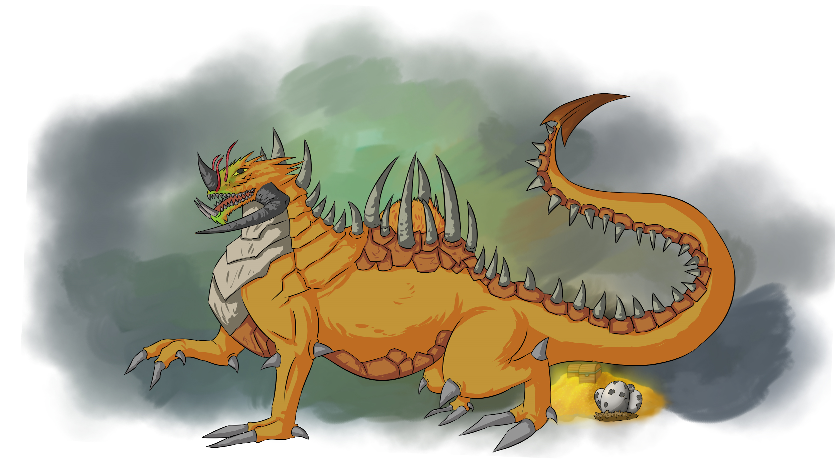
Color Gene #2- Mendelian
Trait
These colors will only be seen if the Operator Color Control Gene is homozygous recessive or [cc]
Green [GG, Gg]
Is Dominant over
Yellow [gg]

Slide 21
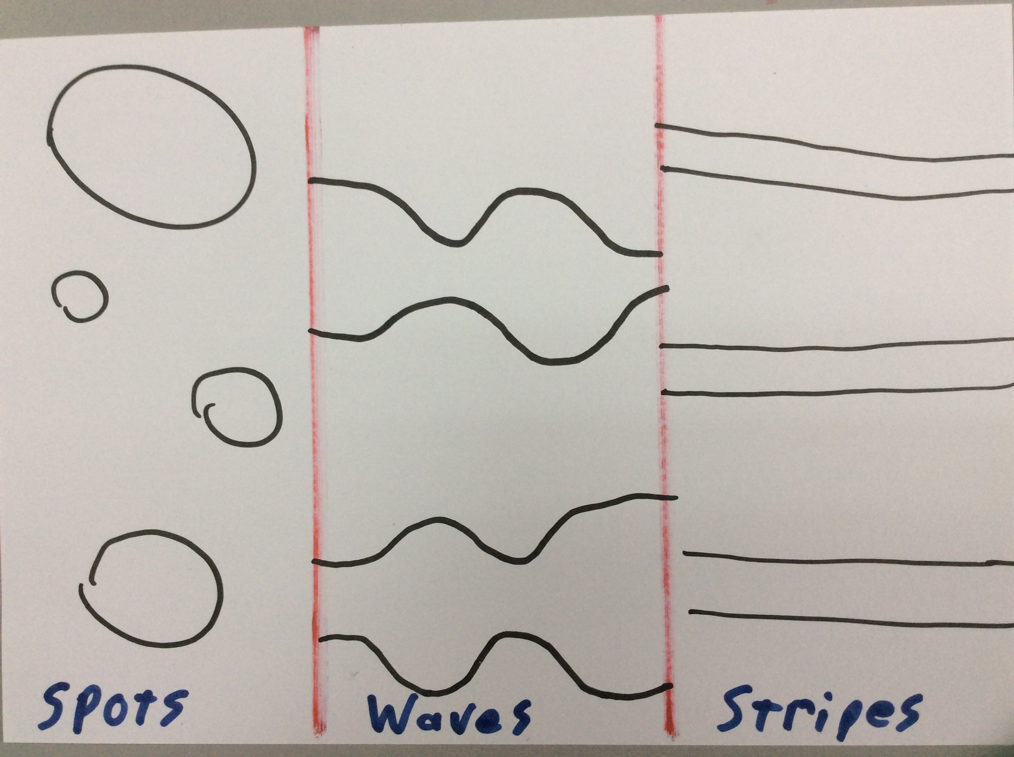
Color Pattern- Codominance, Sex Linked, & Epigenetic
Trait
Sex Linked- Only males show patterns. Much like a male peacock's tail, the pattern is used to help attract females. Females have the same patterns but but red stripes on a red body make them unobservable in females
Epigenetic- The expression of some genes are affected by the organism's environment, diet, and interactions. These traits are known as epigenetic traits.
The color of the pattern in males is dependant
on what the male dragon eats.
Black = human Brown =cows, pigs, deer
White = birds Grey = fish
The pattern shape is a Codominant trait
S1S1= Spots
S1S2 = Wave
S2S2 = Stripes
A very rare example of Sir Deric’s notebook art.

Slide 22
Toe Number- Incomplete
Trait
5
Toes
4
Toes
3
Toes
Toe number is very important to some dragons. On Earth, only the Chinese Emperor could use porcelain with 5 toed dragons. Three toes was considered the commoner dragon.
5 Toes[TT] is Incompletely dominant with
3 toes [tt] resulting in
4 toes [Tt]

Slide 23
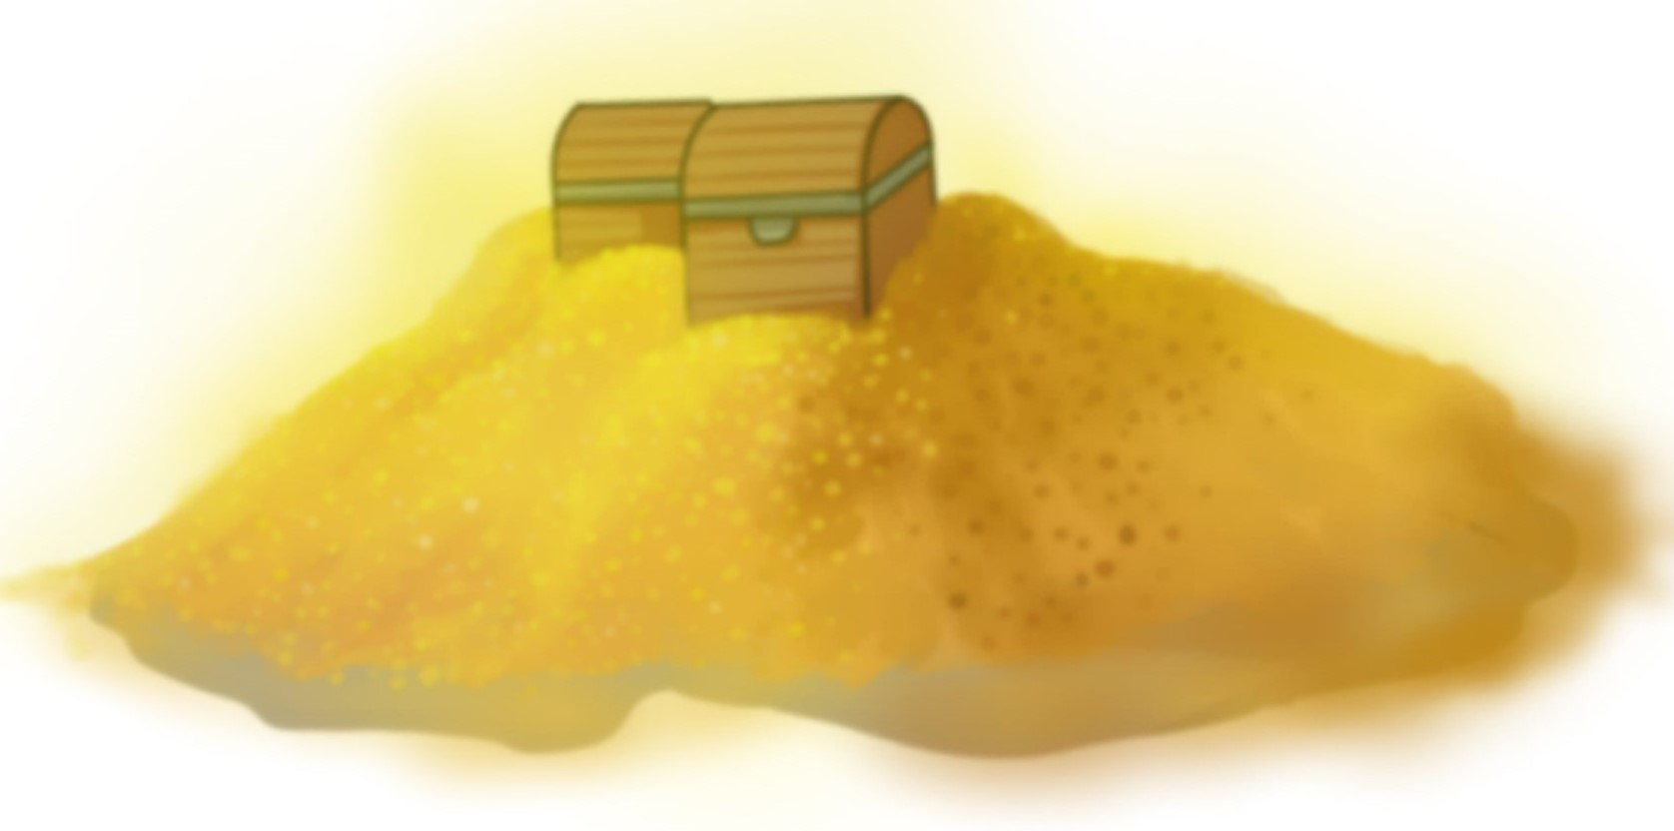
Treasure Lust- Mendelian
Trait
Over time, most local humans have reached an accomodation with the local dragon subspecies. Treasure Lust can cause friction between humans and dragons because some dragons like to hoard treasure. Some humans specifically make small novelty items that the dragons can and will collect in place of gold coins and gems. Some human speaking dragons now own the largest collections of “collectables” on Planet XY.
[TT, Tt] = hoarding behavior
[tt] = no hoarding

Slide 24
Horns- Incomplete
Trait
Long Horns >>>
(Bigger than head)
Medium Horns >>>
(As big or smaller than the head)
Small Horns >>>
(Absent or “bone bump”)
This gene just codes for the presence or absence of horns. The size (large, medium, small) is an example of incomplete dominance.
Each dragon’s horns grow differently. Shape is up to you.
Large Horns [HH] are Incompletely dominant with
Short (or no) horns [hh] resulting in medium [Hh]
Not Horns

Slide 25
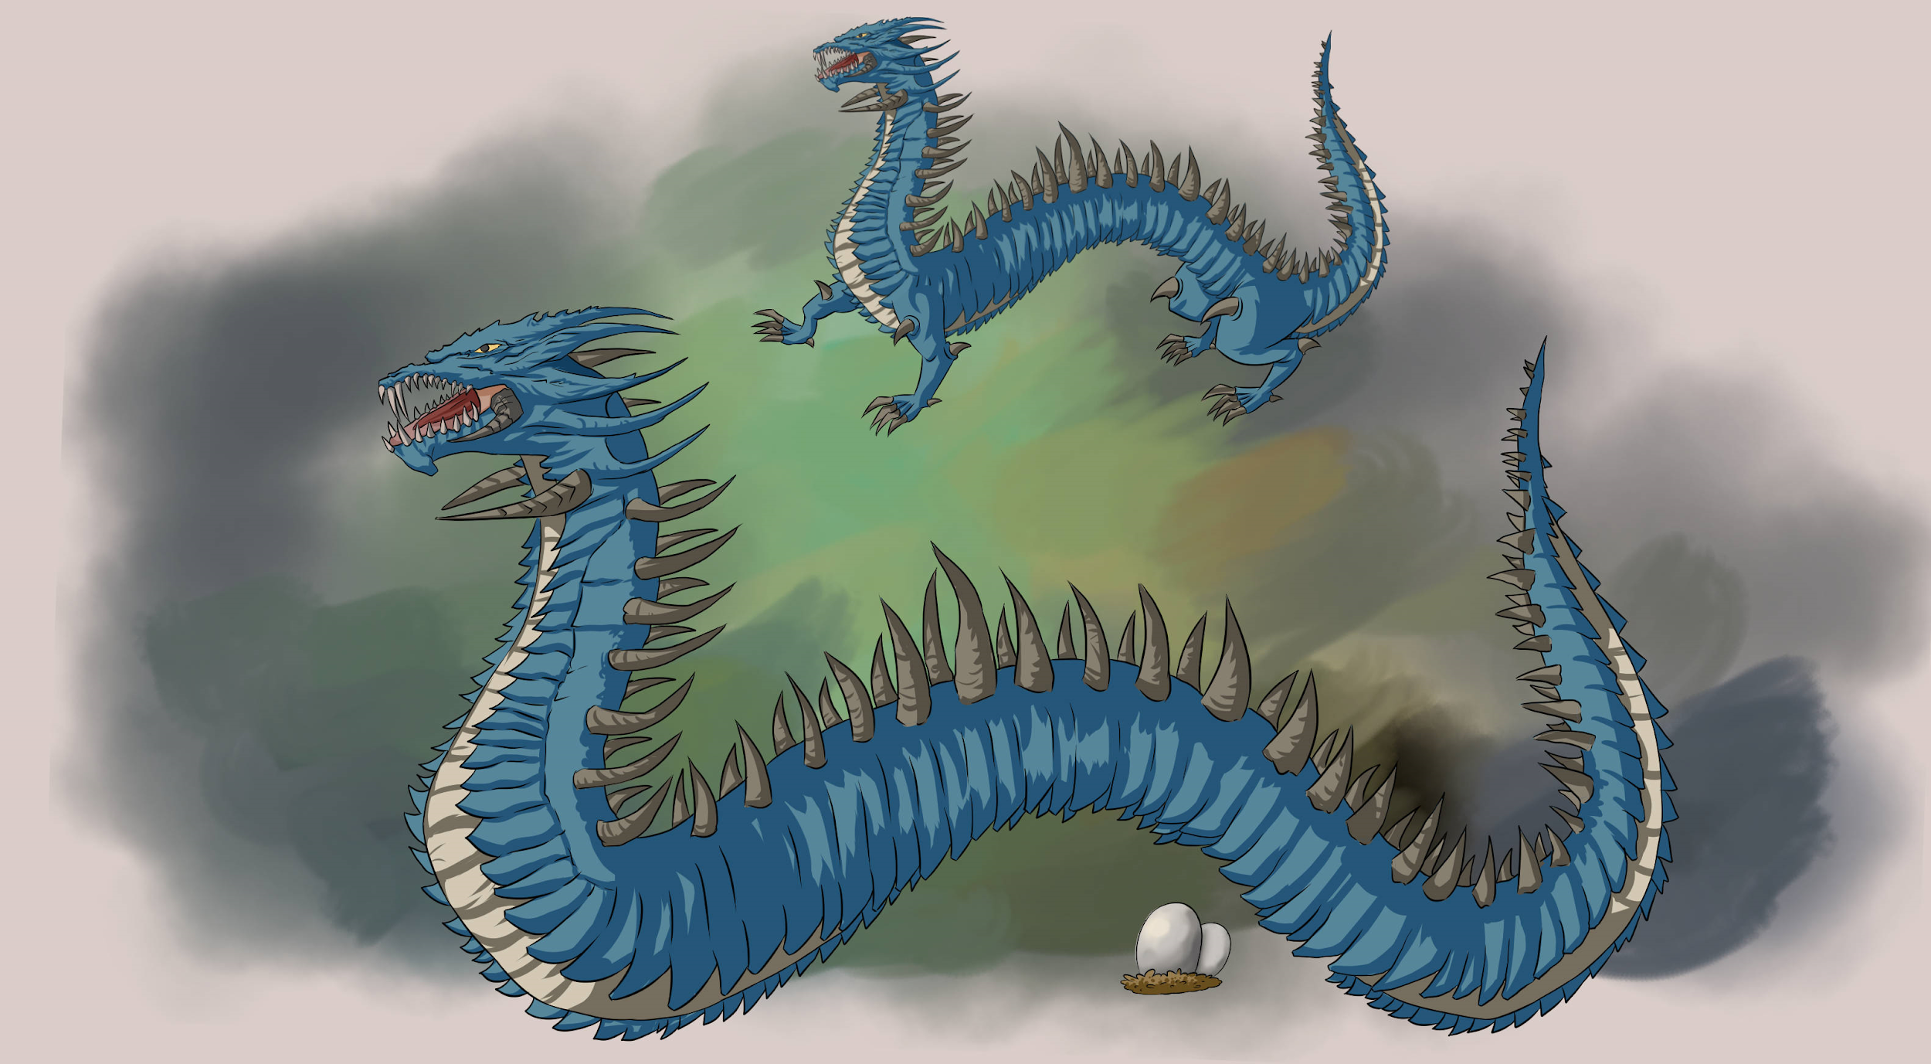
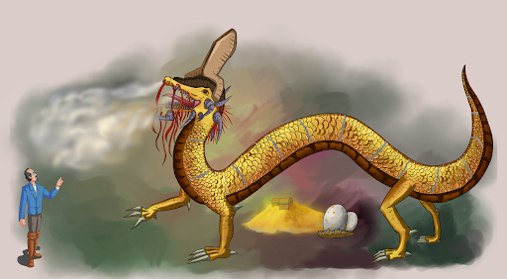
Spines- Mendelian
Trait
This gene just codes for the presence or absence of “Spines” along the back of the dragon. Spine length can vary. Shape is up to you. Spines can even be thin and fibrous.
Spines[SS, Ss] are
dominant to
No spines [ss]

Slide 26
Wings- Mendelian
Trait
This gene codes for visible wings or if the wings are fused with the body.
Wings (visible) [WW, Ww]
are dominant to
No wings[ww]

Slide 27
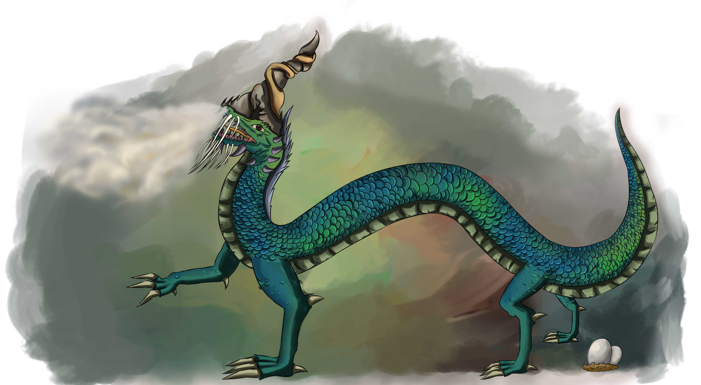
Neck Length- Incomplete
Trait
This gene codes for neck length.
Long neck [LL] is Incompletely dominant with
Short neck [ll] resulting in
Medium neck [Ll]
As a general rule; Short necks are shorter than a leg, Medium are about the length of the front leg, and Long is noticeably longer than a leg.

Slide 28
Tail Spike/Club/Plume- Mendelian
Trait
This gene codes only for the presence or absence of a tail spike. The shape of the spike is variable (be creative). Feel free to create a new tail spike..
Tail spikes [TT, Tt]
are dominant to
No spikes[tt]
No Spike
Tail Spike or Plume

Slide 29
*Feathers*- Mendelian (New Trait/Gene)
Trait
The presence of feathers is a new trait/gene on Planet X. Not all dragons even have the gene. In order to express this gene the dragon needs to be diploid AND have at least 1 dominant gene.
Feathers [FF, Ff]
are dominant to
No Feathers [ff]
1 copy of F or f still codes for no feathers

Slide 30
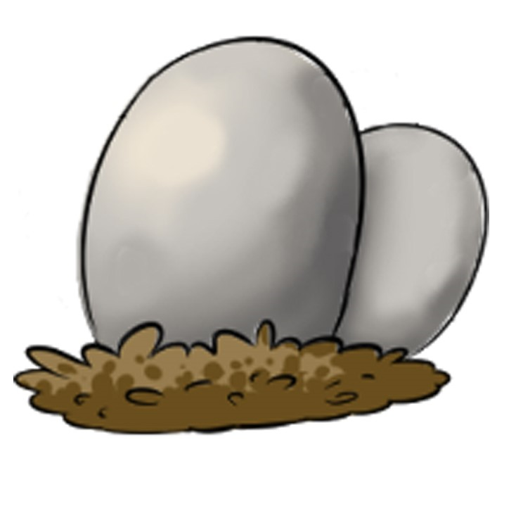
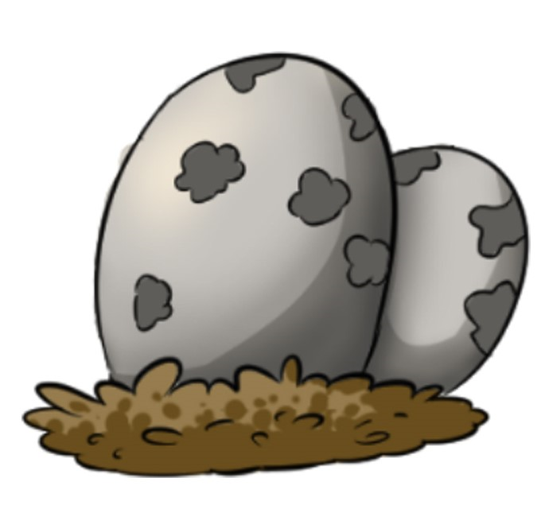
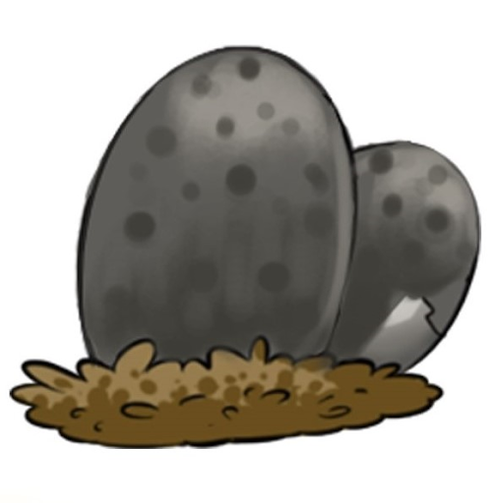
Egg Color- Codominance
Trait
Egg color is a Codominant trait
[WW] = White
[GG] = Grey
[WG] = White and Grey

Slide 31
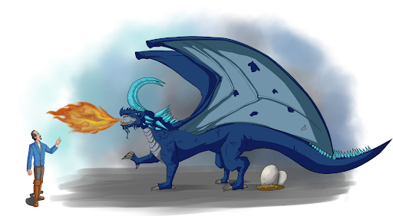
Fire breathing- Mendelian
Trait
There is no trait more “draconian” than fire breathing. Even dragons who do not breath fire produce a roar that will scatter humans, and cause animals to run for their lives. Some fire breathing dragons can drink water to then create steam or “cloud breath”
Fire breathing [FF, Ff]
is dominant to
No fire breathing [ff]

Slide 32
Tendrils- Incomplete
Trait
Sir Nelson refers to dragon tendrils as “the facial hair of dragons” Long Tendrils are denoted by at least two particularly long tendris.
Long Tendrils[TT] are Incompletely dominant with
No Tendrils[tt] resulting in
Short Tendrils [Tt]
Long
Medium
Short (none)

Slide 33
Speak Human- Mendelian
Trait
Dragons are intelligent and communicate with one another. Some can communicate with humans, but it can be hard to talk and breath fire at the same time which may explain why speaking human is a recessive trait. Speaking and understanding are not the same.
Let people know you can speak human by placing a human or a speech bubble on your picture
Not speaking human [SS, Ss]
is dominant to
Speaking human [ss]
It warms me to see you

Slide 34
Sex Chromosome- Gender Determination
Trait
Dragons, like humans, have an X and a Y chromosome. Like humans, a male dragon can donate an X or a Y chromosome. As with humans, some traits are said to be sex linked if they are carried on these chromosomes.

Slide 35
Endurance 1-
Incomplete
Trait
Endurance is a measurement of physical endurance.
You will take 3 steps forward when picking a mate [EE]
You will take 2 steps forward when picking a mate [Ee]
You will take 1 step forward when picking a mate [ee]
There will be 1-2 mating flights during this activity. Dragons choose “fit” partners by engaging in mating flights. In class everyone will line up, males and females facing each other. You will be able to take steps towards the other line. Those individuals farthest from their starting line choose first. Females who are farther away or equal to a male distance from the starting line pick mates first. Males can only choose a female if they have greater endurance. Females usually pick males based on endurance (distance from the starting line), but other features may be seen as desirable.

Slide 36
Endurance 2-
Sex linked
Trait
Found only on the X chromosome. As a result females have 2 copies, males have only 1 copy.
[EE] 2 steps forward
[E] 1 step forward
[Ee] 1 step forward
[e] Nothing
[ee] 1 step back
There will be 1-2 mating flights during this activity. Dragons choose “fit” partners by engaging in mating flights. In class everyone will line up, male dragons and female dragons facing each other. You will be able to take steps towards the other line. Those individuals farthest from their starting line choose first. Females who are farther away or equal to a male distance from the starting line pick mates first. Males can only choose a female if they have greater endurance. Females usually pick males based on endurance (distance from the starting line), but other features may be seen as desirable.

Slide 37
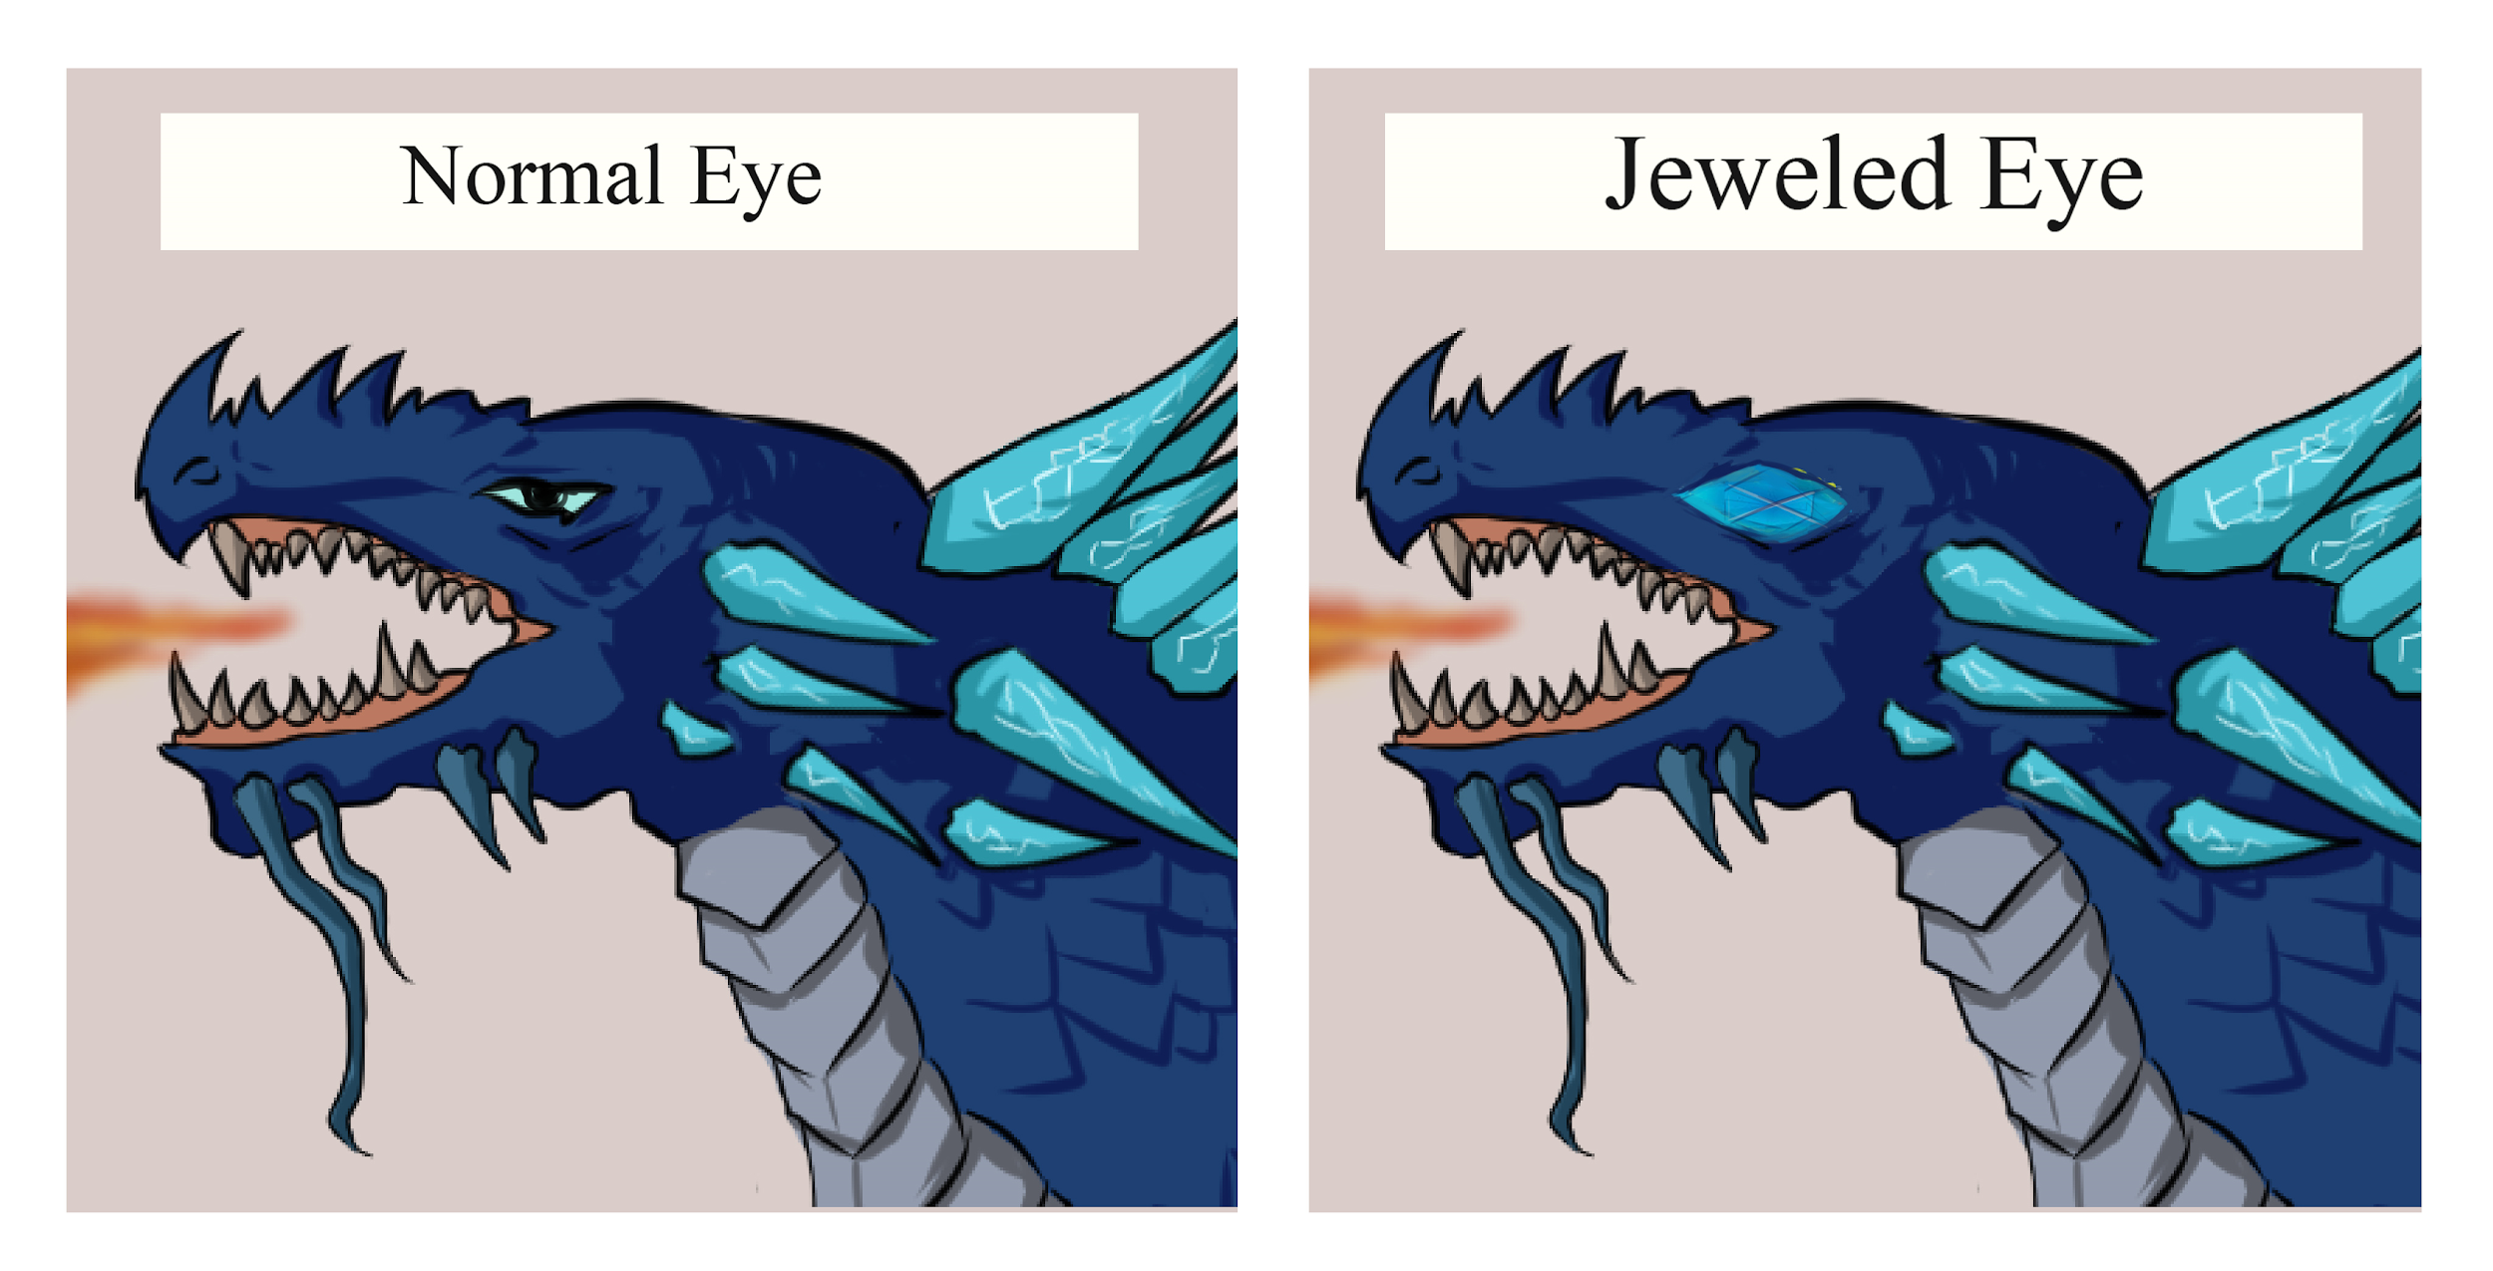
Jeweled Eyes- Sex linked genetic disorder
Trait
Like Red/Green color blindness in humans, some dragons suffer from jeweled eyes. Jeweled eyed dragons can see better in the dark, but daylight is very uncomfortable for them. It is recessive.
To have jeweled eyes you need to be;
[jj] in females and
[j] in males
Any [J] allele will mean normal eyes.

Slide 38
Part 3- The Dragons of Planet XY
All dragons on Planet XY are the same species. This means that they can breed and share genetic information (genes).
However, there are different breeds or subspecies of dragons. This means that, over time, regional differentiation of the gene frequency has developed. More simply, this means that certain traits, such as color, have different common phenotypes in different regions.
A species is a group of potentially interbreeding populations with a common gene pool, which are reproductively isolated from other populations. In this activity, all of the dragons can mate, and are thus the same species.
Gene pool - This is the complete set of unique alleles in a species. For example, having wings [W] is one and not having wings [w] is another. A capital letter denotes that the alle is dominant over another.
A breed is a stock of animals (or plants) within a species that has a distinctive appearance and is typically the result of deliberate selection. On Earth, that is being done by humans, but on Planet XY, the dragons are doing the selection.

Slide 39
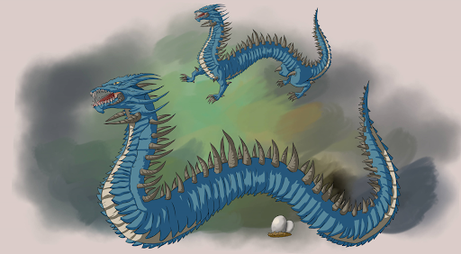
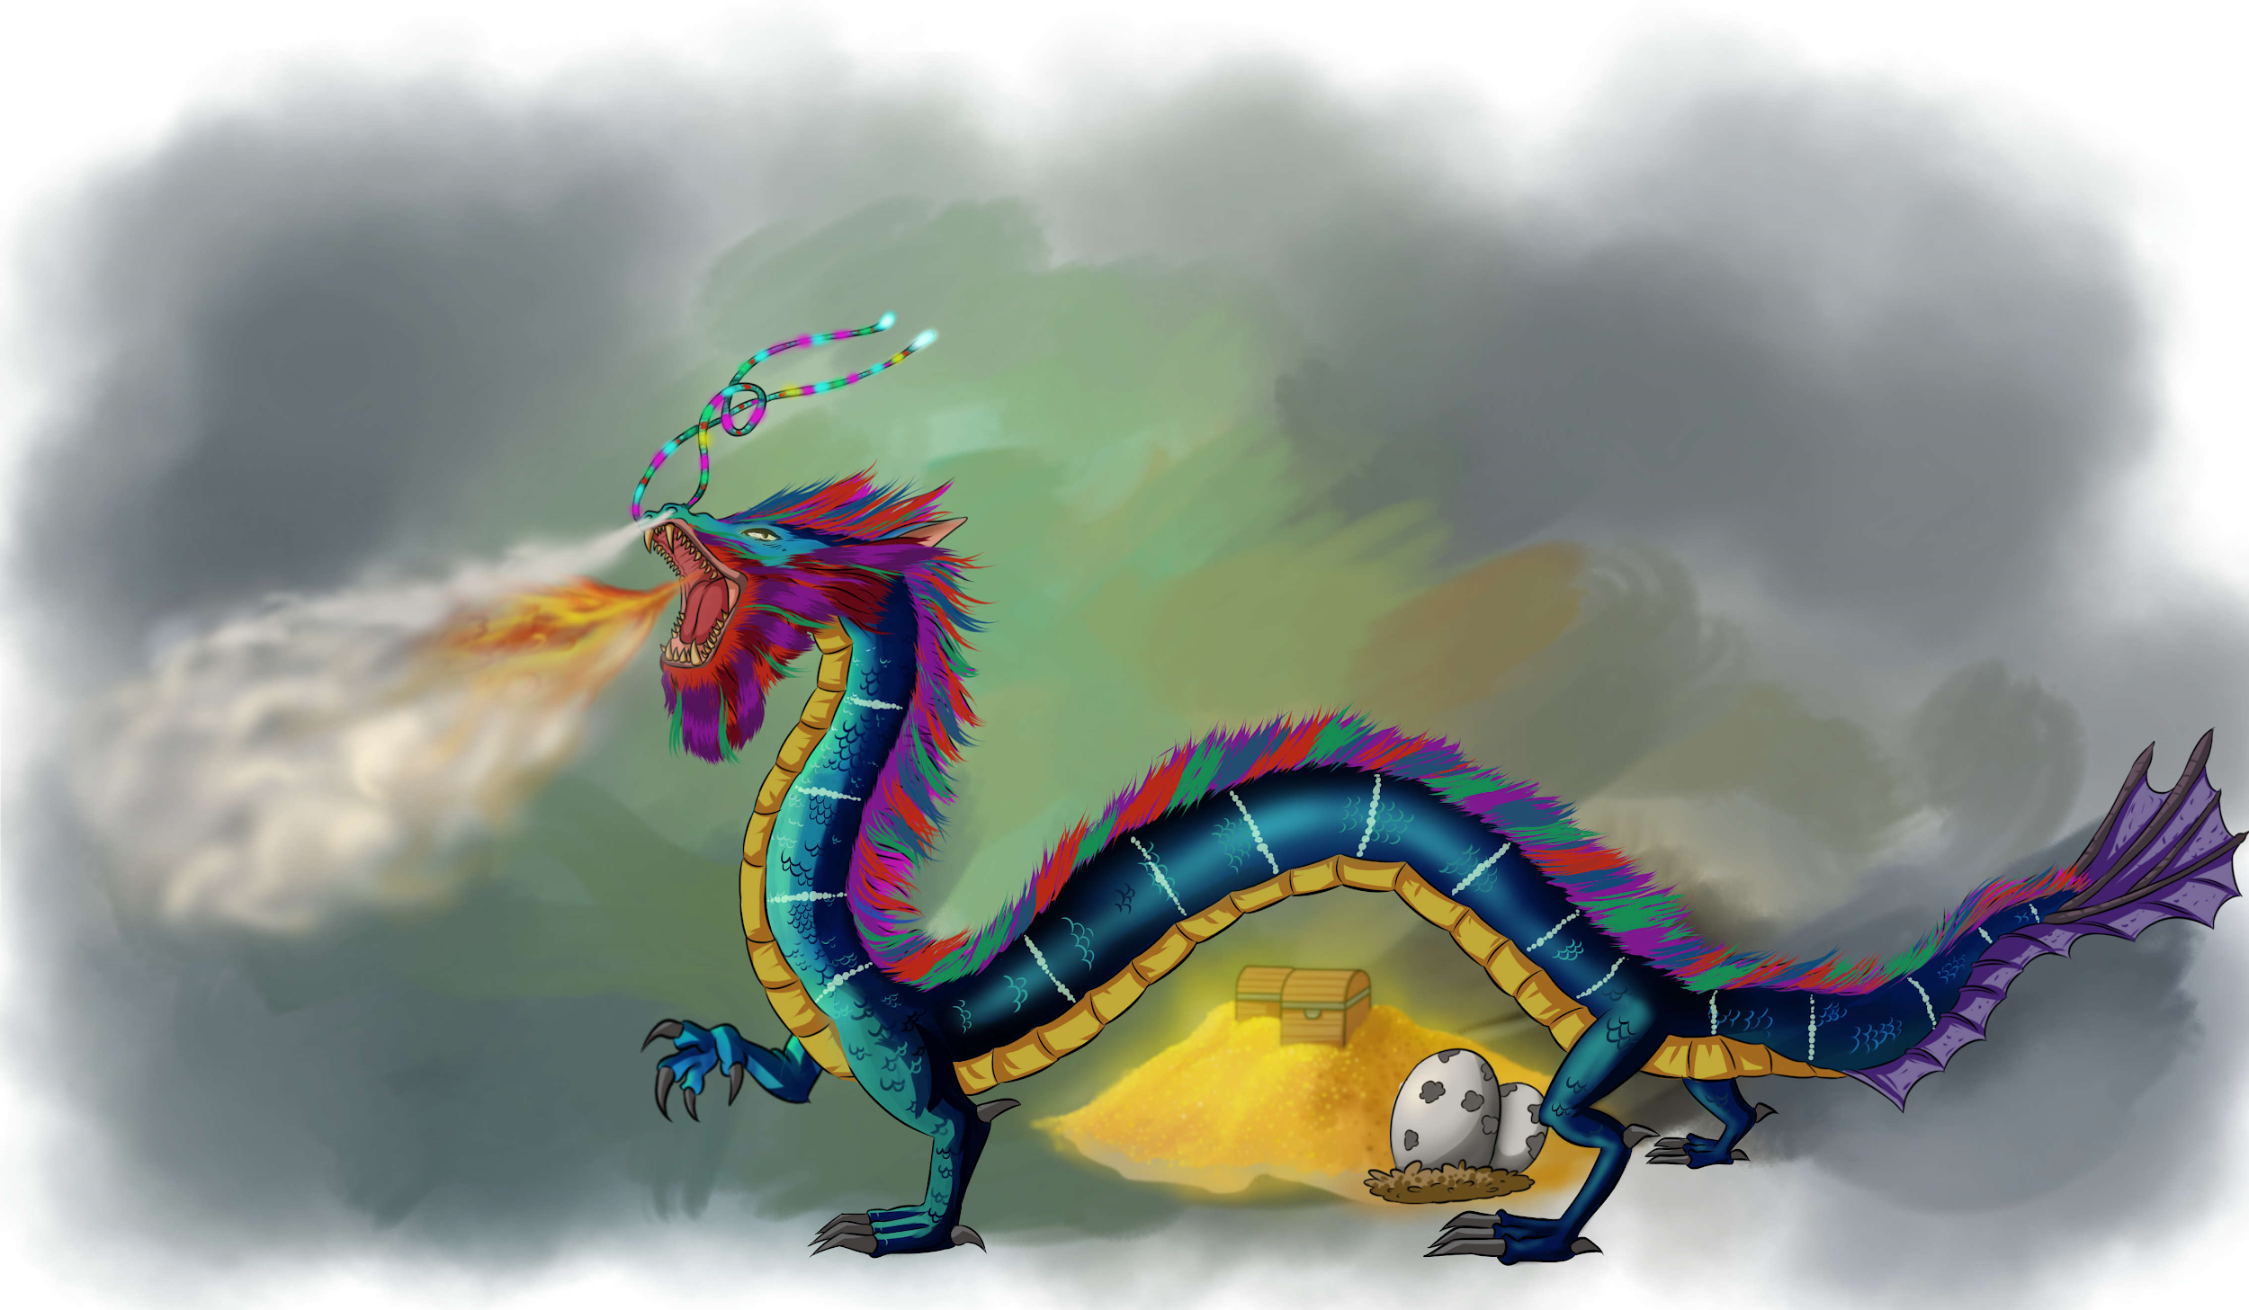
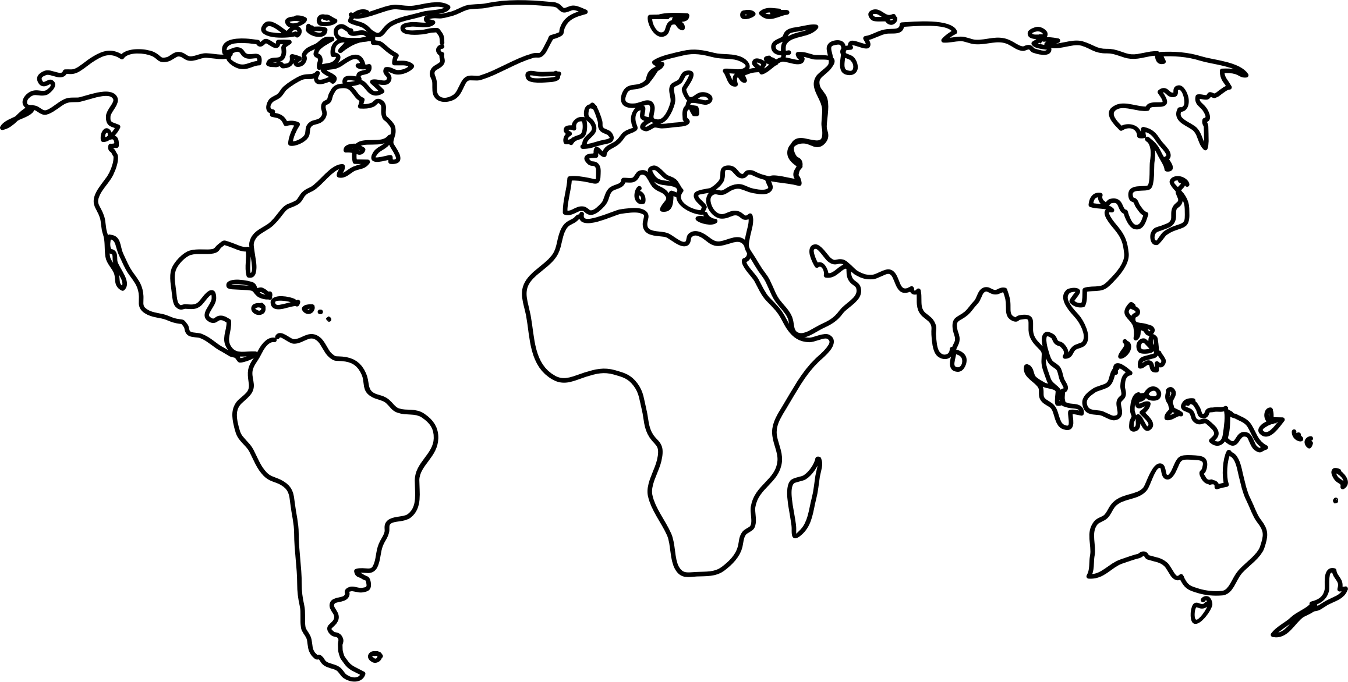
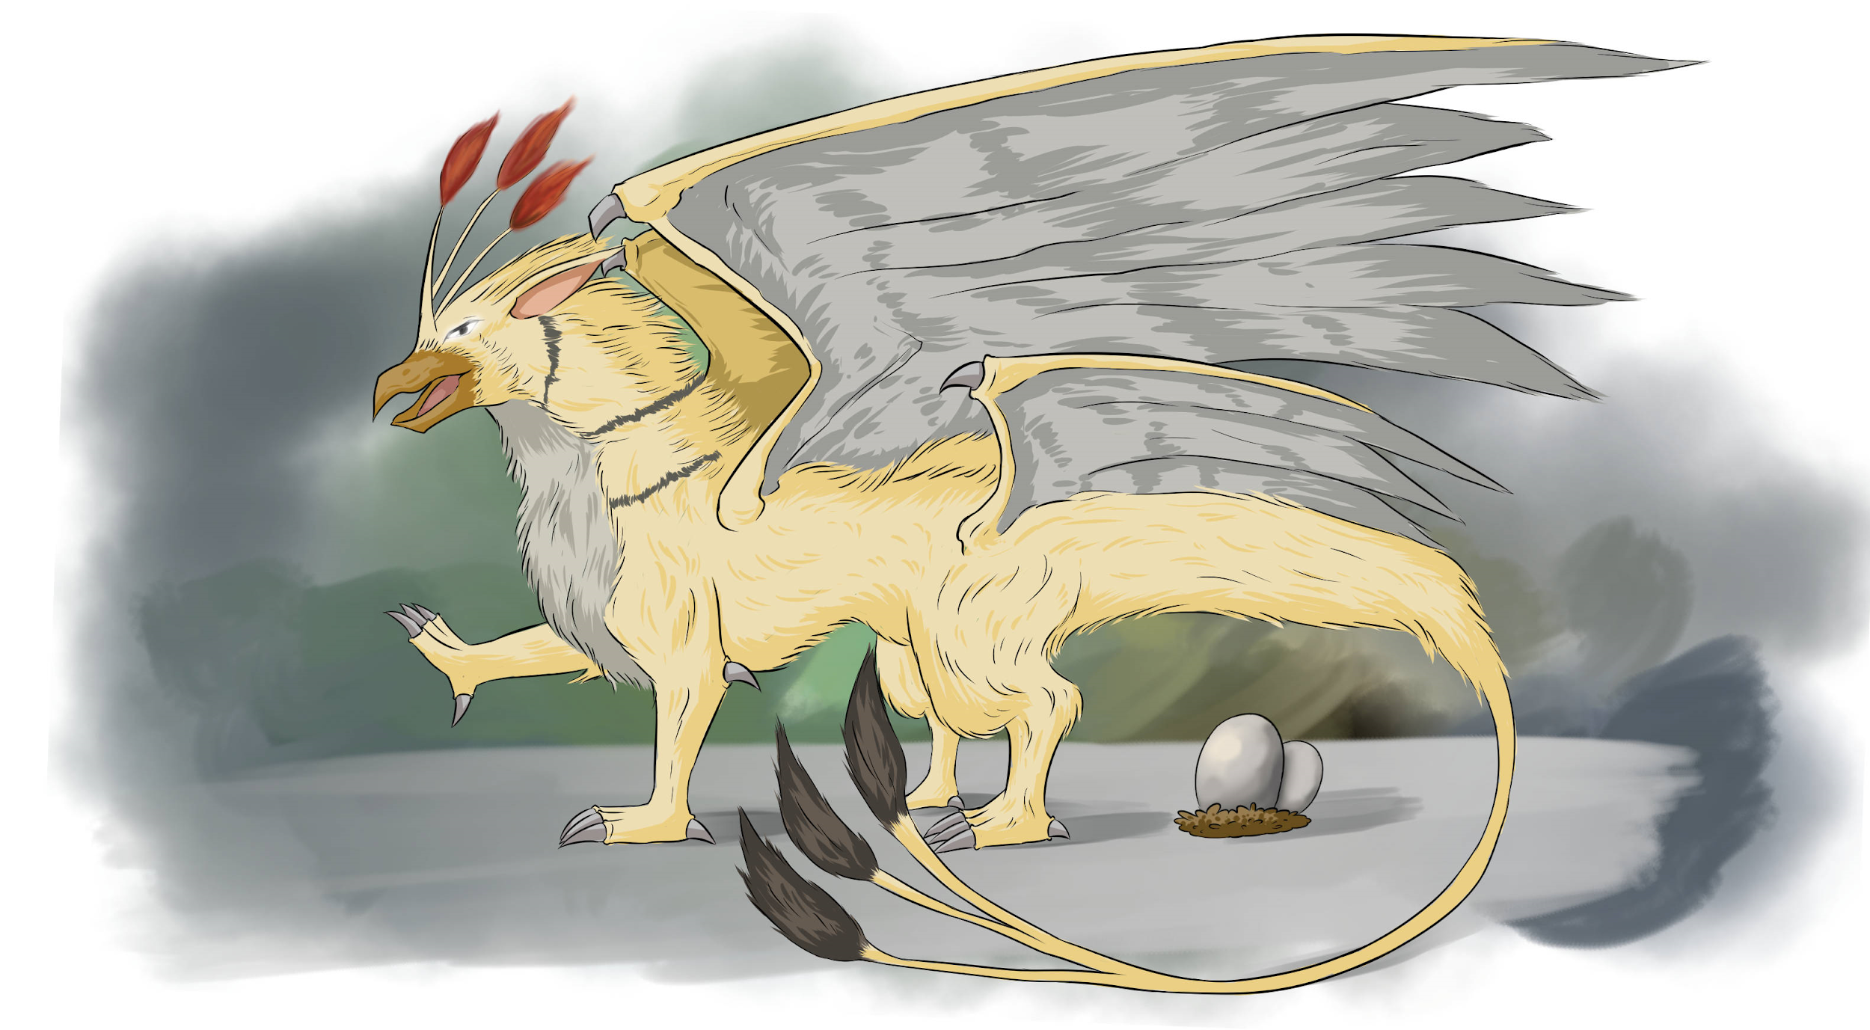
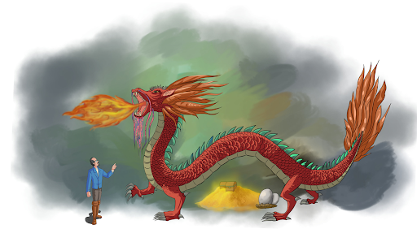
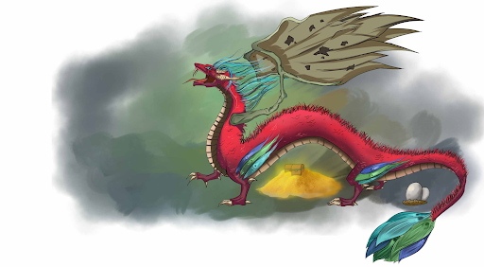
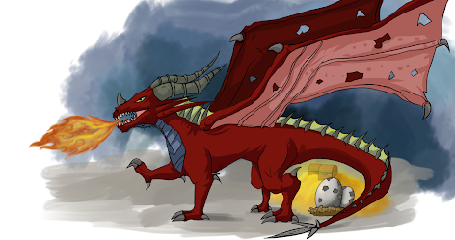
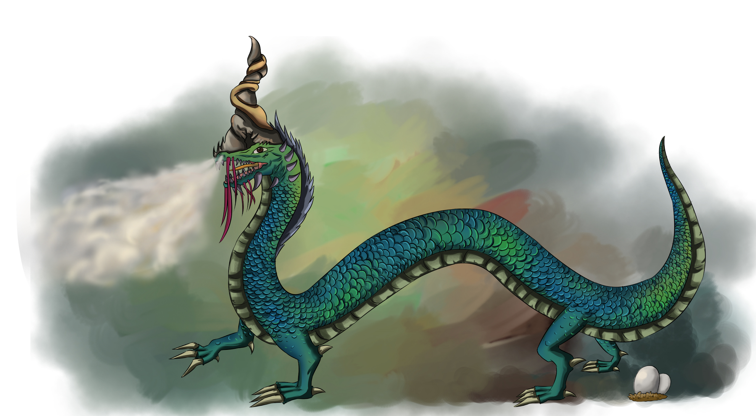
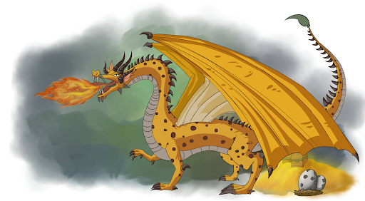
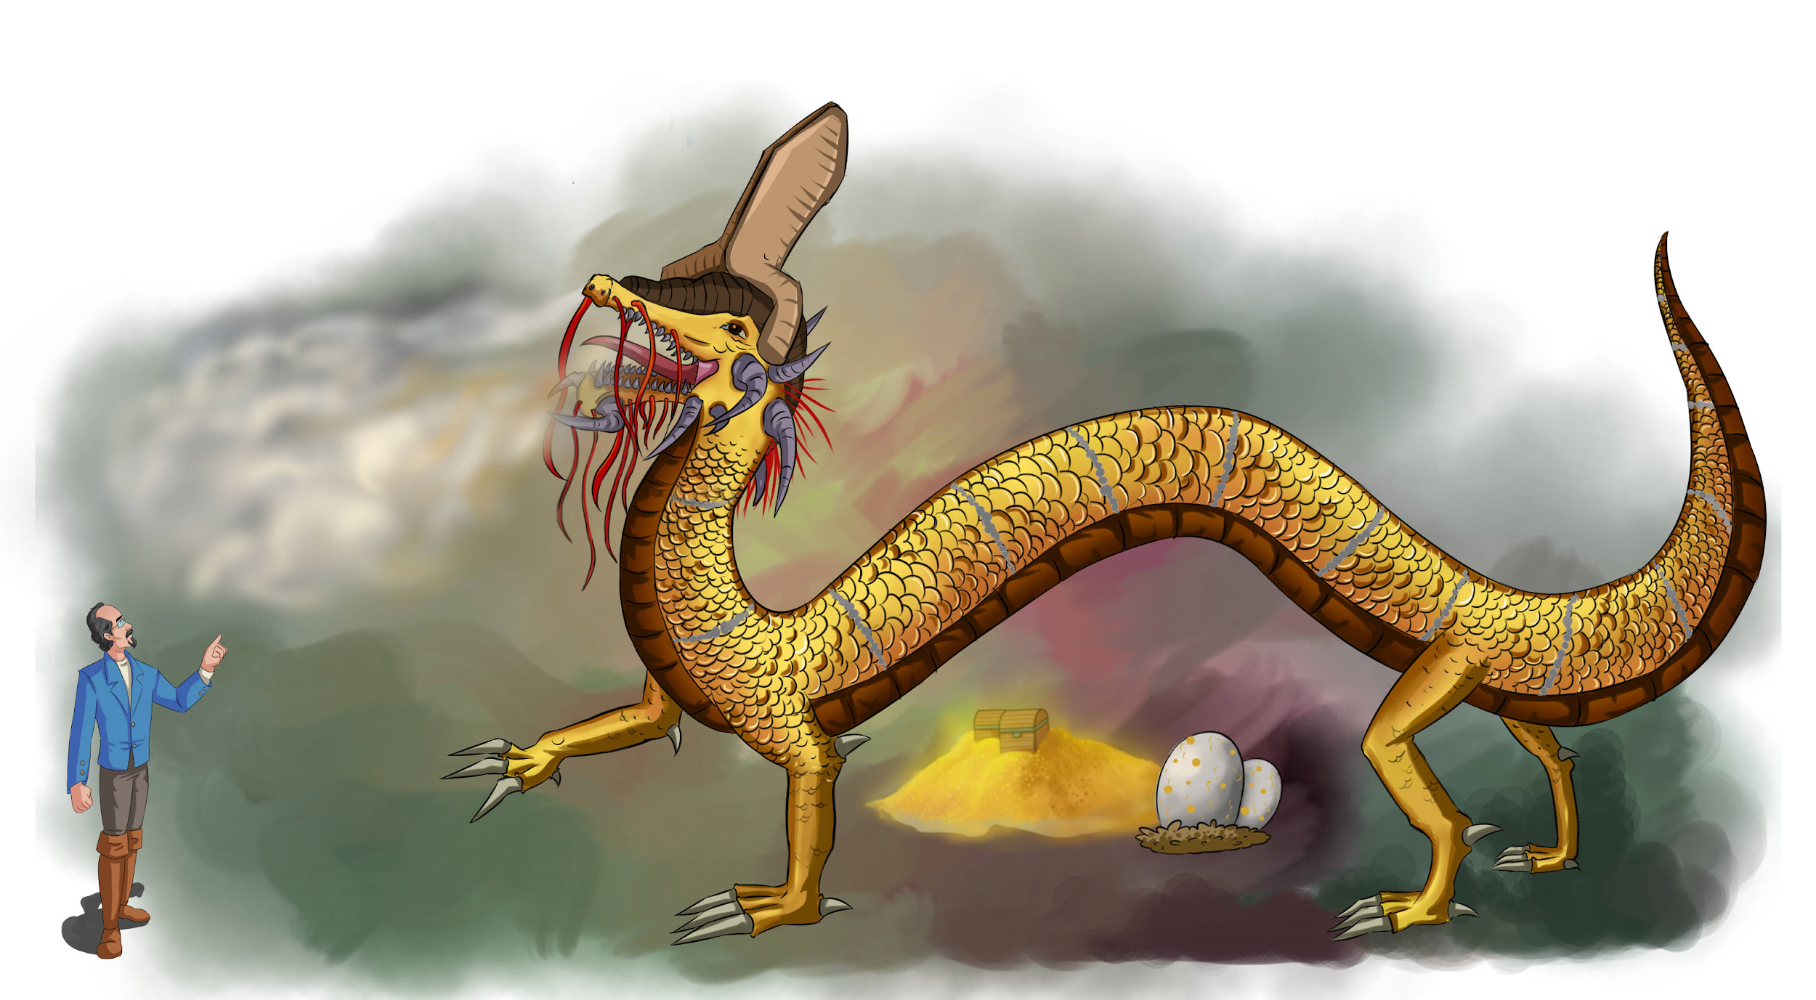
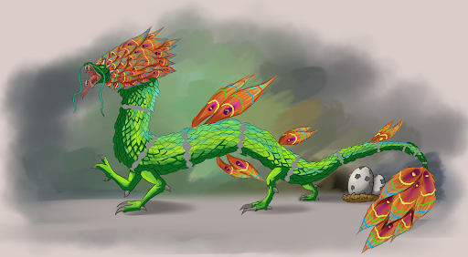
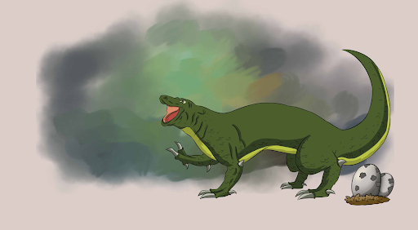
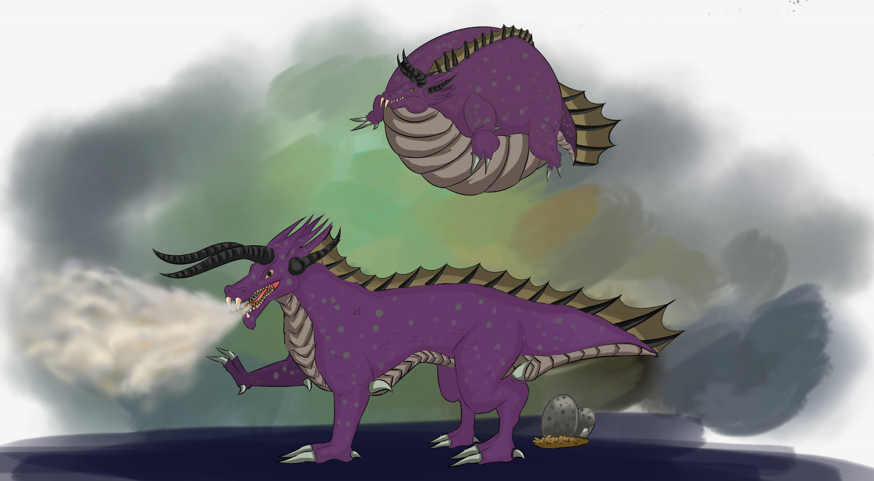
Subspecies of Dragons on Planet XY
Saxon Red
Carpathian Dragon
Siberian Wurm
Kamikazee
Glacier Dragon
Thunderbird
Turkish Teapot
Long Wan Die
Mekong Dragon
Quetzalcoatlus
Indus Naga
Amazonian Dragon
Savannah Dragon
Polynesian Windsurfer
Desert Drake
Komodo Bullroarer
Zulu Dragon

Slide 40
What is meant by
a “typical” dragon?
There are 17 sub species or “types” on Planet XY. As a class you will be presented with a “typical” member of each subspecies. Pictured is either a male, or a female of the type. Within each breed is sometimes a great deal of variety. Not all dragons of a breed look like the pictured dragon for some traits. Any trait that is heterozygous in both parents will produce offspring where only ½ of them continue to be heterozygous for that trait. The pictured dragon does represent our starting “typical” dragon. Some breeds of dragon have a great deal of variety (the Carpathian), while others have very little variety (Komodo Bullroarer) within the breed. Other than being purple (thus male) or having a pattern, there is no observable phenotypic external trait that distinguishes between a male and a female of a subspecies. They know.

Slide 41
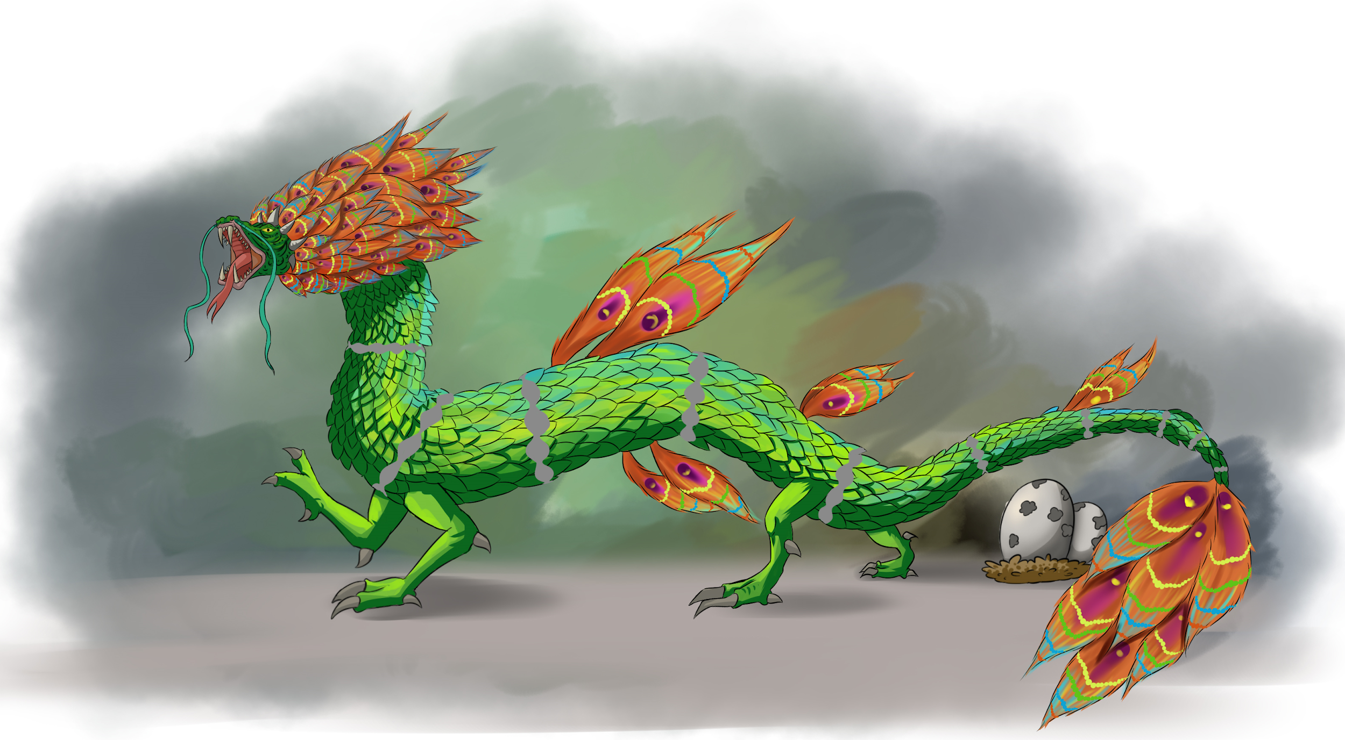
Amazonian
Dragon
Explain one phenotypic trait from the picture of the Amazonian Dragon and explain the survival advantage to have a population that is homozygous dominant for that trait.
Sir Nelson’s Notes:
In all of my travels, the Amazonian Dragon is one of the more reclusive breeds of dragon on the planet. The “ghosts of the forests” are unique in a number of ways. The Amazonian dragon is one of the smallest of the dragon breeds. Their coloration, size, and behavior make it very hard to see them in the lush greenery of the tropical rainforests which are its home. On an expedition up the Amazon river to observe this dragon I was told we twice passed a hiding dragon without me laying eyes on the dragon in question. My first, and perhaps best, observation came while I sat in the shade of a tree sketching a leaf when I saw a young male in a clearing on the other side of the river taking a drink.
They are unusual in dragon types in that they spend most of their time, including sleeping, in the canopy of the lush rainforests that dominate the area. The Amazonian dragon is somewhat unusual for showing no interest in swimming in the river that gives the region and dragon type its name. The presence of electric eels in the murky waters may explain why the Amazonian breed feeds primarily on birds in many locations. As long as the vast forest in which it lives stands, the Amazonian may continue to be the least understood of all the breeds

Slide 42
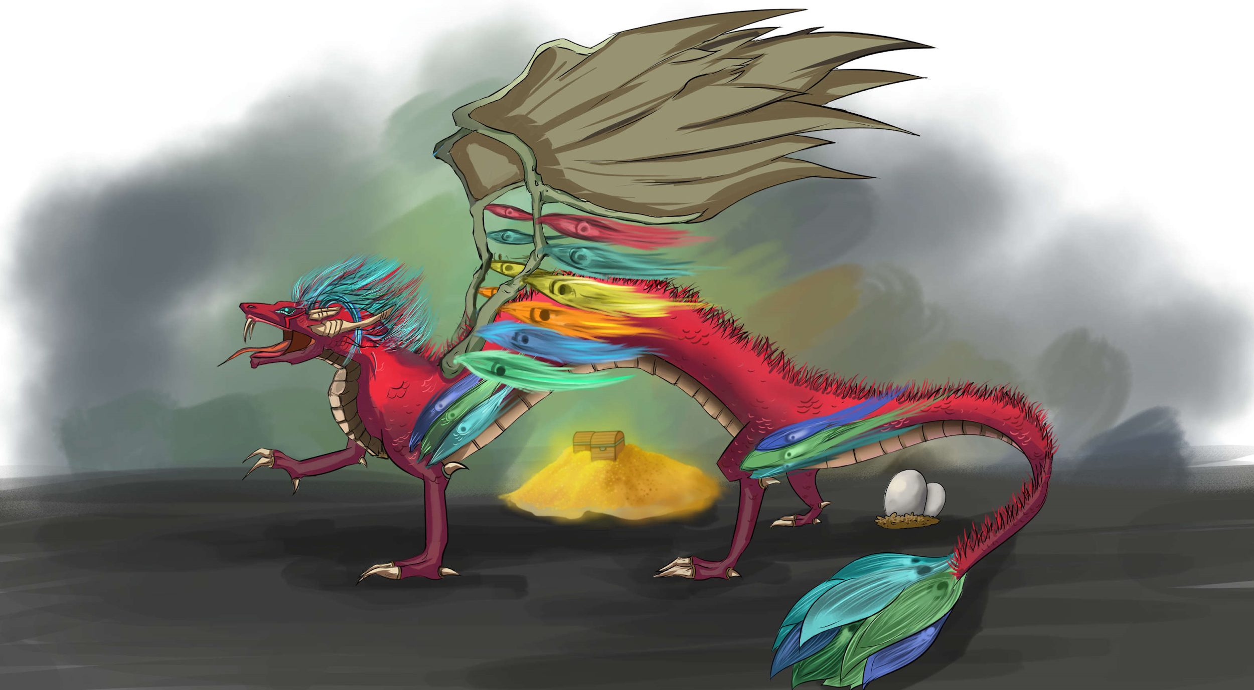
Quetzalcoatlus
What creatures on planet Earth (now or in the past) also have the name Quetzalcoatlus?
Sir Nelson’s Notes:
One of four types of dragons to develop a durable social symbiosis with the local human culture. The large stone dragon platforms of Chichen Itza, Tikal, Caracol and elsewhere brought dragons into the very heart of Mesoamerican culture. Entire cities were designed around the desire to have a mated pair of “the great Feathered Serpents” take up residence in a temple built for that purpose. Legends have it that in the past another breed of dragon demanded human sacrifice, but that the great Quetzalcoatlus came to vanquish them forever.
Quetzalcoatlus is unusual amongst dragons in its reaction to the sex linked trait “jeweled eye”. Because of the discomfort daylight can cause stricken individuals, Quetzalcoatlus with this condition tend to be much more active at night just like other types. What is unusual is the interest unaffected Quetzalcoatlus have in those with the trait. This interest extends to the frequency with which all Quetzalcoatlus spend time out at night “singing” to the stars.

Slide 43
Thunderbird aka Rocky Mountain Dragon
Why might the trait for wings in dragons move from Glacier Dragons to Thunderbirds, but the feather trait not move from Thunderbirds to Glacier dragons as easily?
Sir Nelson’s Notes:
The Thunderbird, aka the Rocky Mountain Dragon and aka the “Golden Eagle Spirit” is known for its beautiful golden feathers. Though rarely a fire breather this dragon is able to produce an incredibly loud call that sounds like rolling thunder at a distance. Without a doubt it is the most prodigious of all dragon flyers. So much so, I must confess, it makes it very hard to observe or contact. Spending hours at altitudes much higher than its fellow dragons, sightings and interactions on the ground can be very rare. Possessed of a unique secondary wing which is used to achieve the stunning aerial acrobatics for which this type is duly noted.
Coming together only to “dance in the air” this type tends to be solitary. The Thunderbird rarely communicates with humans, even in individuals with the trait for human speech. I travelled to the territory of Seattle to try to make contact with a Thunderbird known to have had human conversations in the past but to no avail. When they do actually speak to humans their words are given great consideration. Admired for their independent nature, many examples of the money throughout the Northern Americas features the “Father and Mother of all Eagles”.

Slide 44
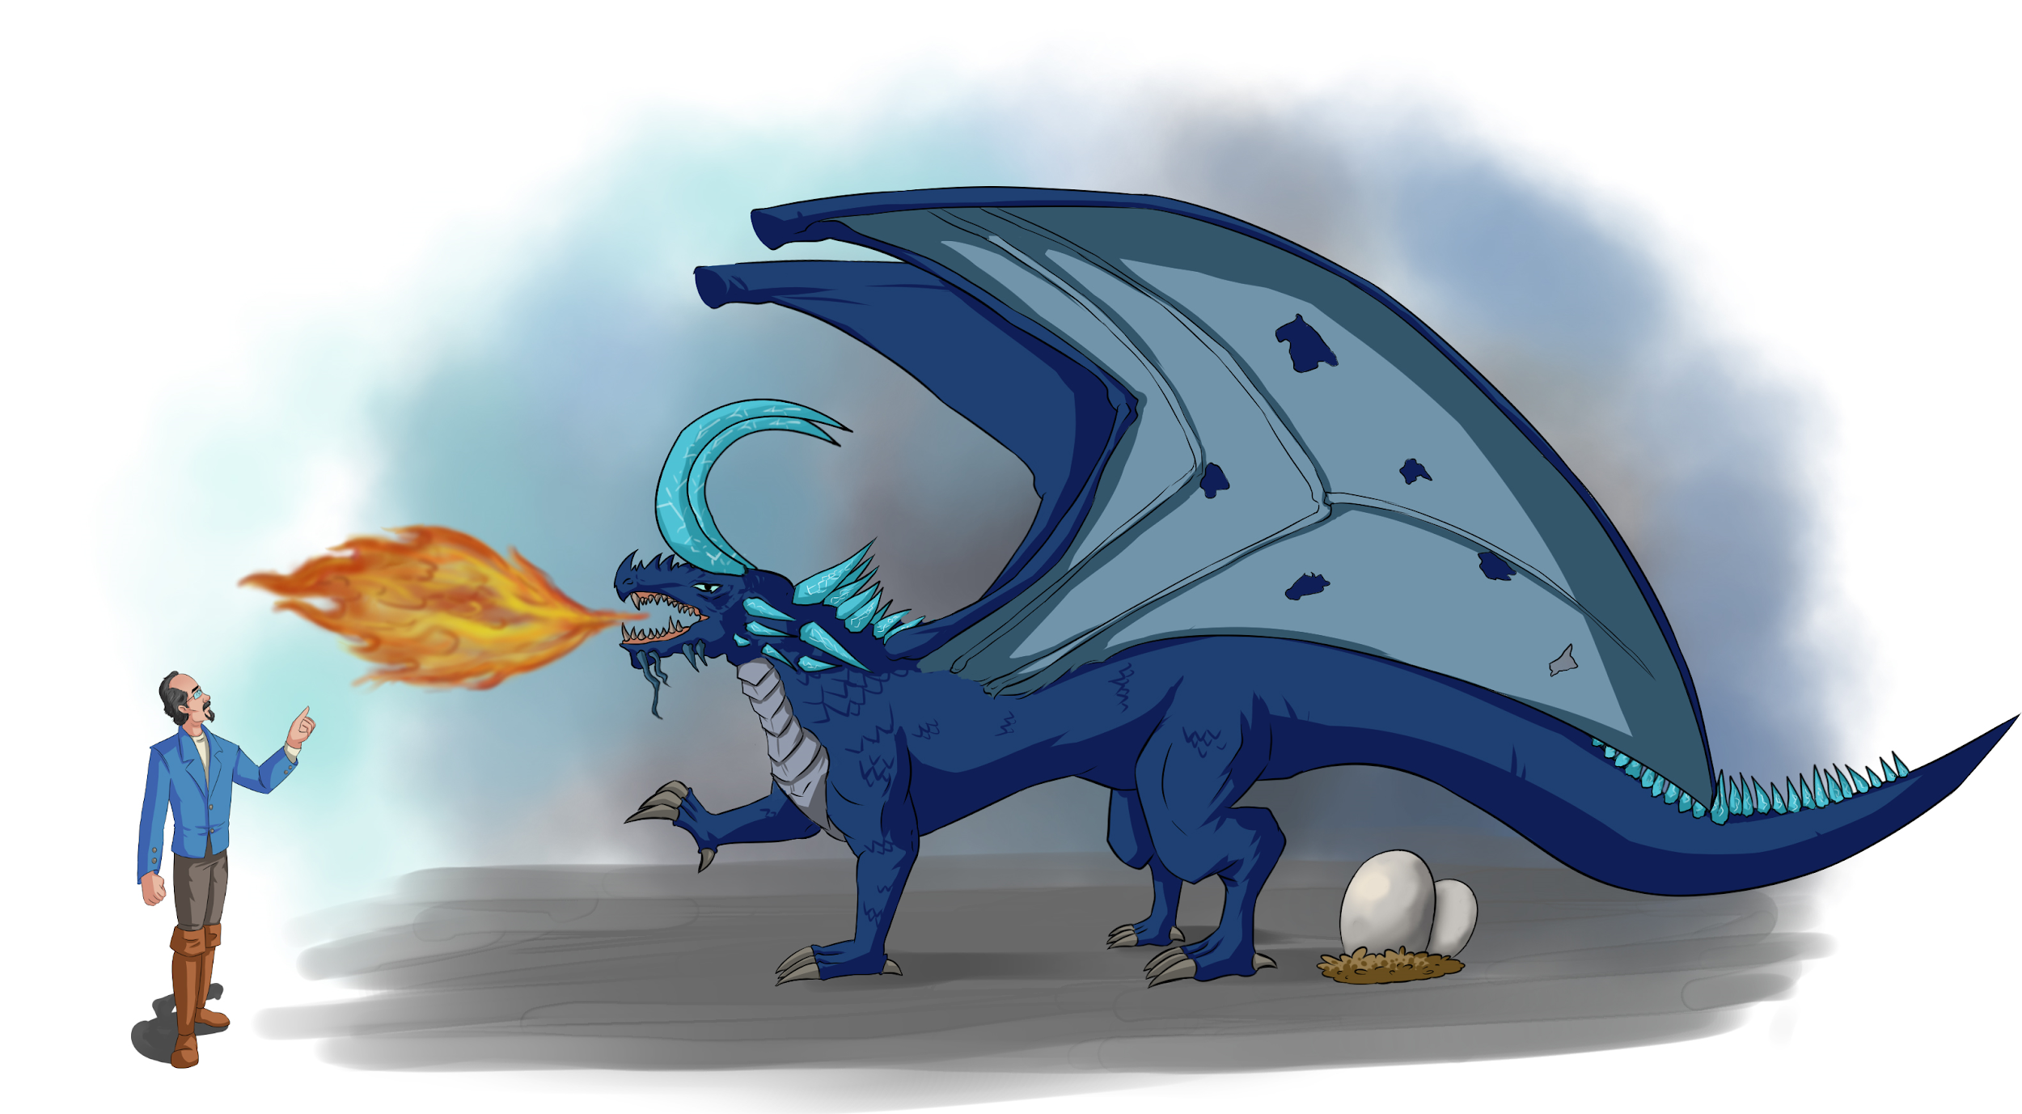
Glacier
Dragon
Why would wingless ancestors result in wingless progeny?
Sir Nelson’s Notes:
The Glacier Dragon is a bit of a mystery. A very solitary dragon, few humans have encountered this dragon in the wild. Though found in the New World it shares many characteristics with its Old World cousins. In particular this dragon shows no evidence of feathers. It was once speculated that a wingless dragon ancestor arrived in the Americas and gave rise to the feathered trait. If a winged dragon (in this case the Glacier) immigrated from Europe, that could explain the existence of the winged trait in Thunderbirds. What is in question is that if there is evidence for occasional interbreeding, why then is there no evidence for feathers moving into the Glacier dragon population. I had the opportunity to speak with a Glacier dragon. They can spend hours reciting histories. Through questioning I am fairly certain that Ayita, the female Glacier I was conversing with, knew of none of her ancestors who had feathers. It is odd for a breed to consistently have this ability, but they seldom get to use that trait.
Though the largest single colony of Glacier Dragons exists on Greenland, this dragon is found throughout the northern ice covered areas of the New World in small numbers. I personally believe that the Glacier Dragon is descended from Saxon ancestors I speculate that during the time of the last major glacial period, winged Saxon’s (or more properly, their ancestors) moved onto the ice that stretched across the Atlantic. I say this in part based on my many conversations between Ayita and her mate which suggested to me that her dragon dialect seemed similar to the Saxon and less so with the Thunderbird dialect.

Slide 45
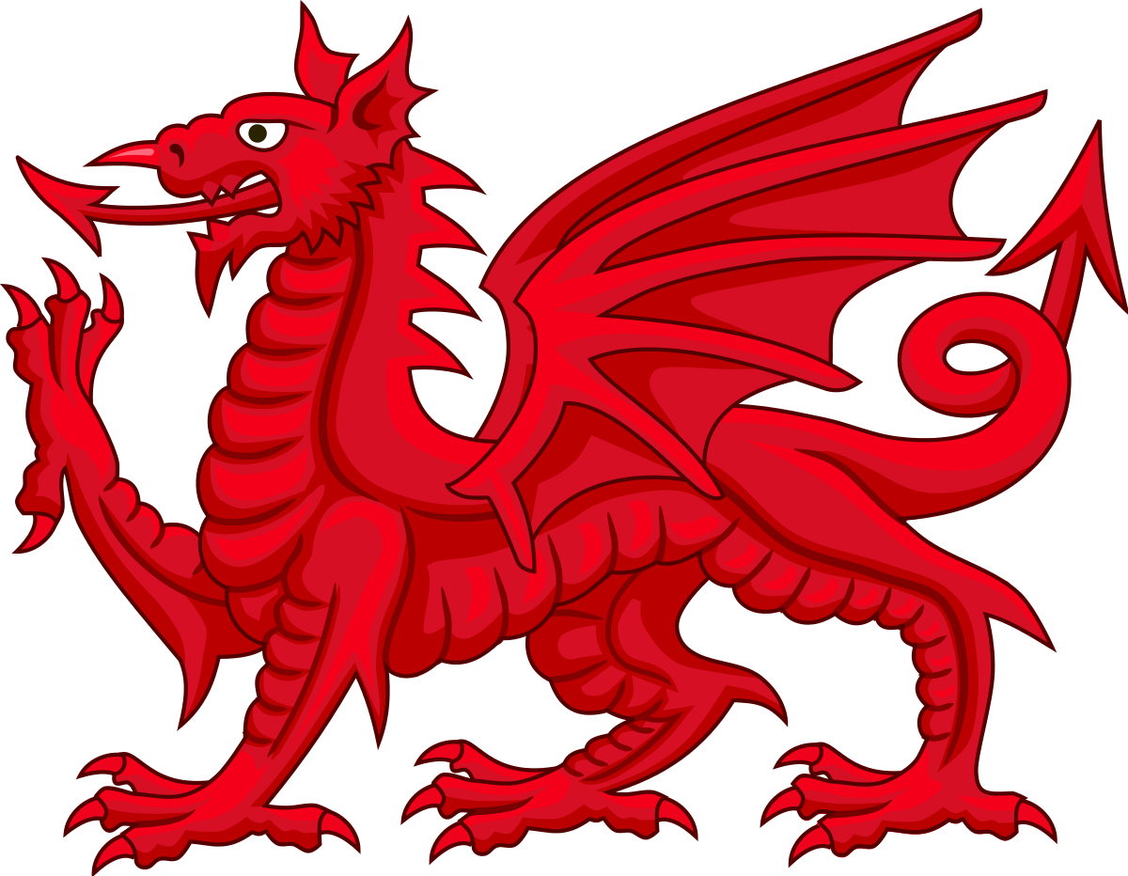
Saxon Red
Dragon
What are some instances in which interaction with humans has changed a species?
Sir Nelson’s Notes:
This distinctive subspecies has only 1 color, RED. Even male color patterns are often hard to see as any color is shifted to a reddish hue. The Saxon Red is often drawn with a long and spiked serpent’s tongue and with horns much shorter than normally found in this breed.. This reflects the fact that, although the Saxon Red has developed an ongoing social interaction with the humans in this region, this interaction sometimes has the appearance of a family squabble. Officially made “the protector of Britain” in 1066, some Saxon Reds have even been knighted, and a total of 9 speaking dragons have held seats in Parliament. In these interactions some members of Parliament found them hard to “understand.” Some humans blamed this on the dragons for their ability to speak but not listen, something I have never observed. Long horns are prized in Saxon Red’s and the short horns and spiked tongue captures a moment in an ongoing social squabble between human and dragon where this squabble became more public..
Having grown up with the Saxon Red I admit that it is hard to be a “neutral” observer on this type. Some Saxon Reds become “nuisance” dragons when they invade a castle looking for treasure. The Queen is reported to have stated “We are not amused” after one such intrusion.

Slide 46
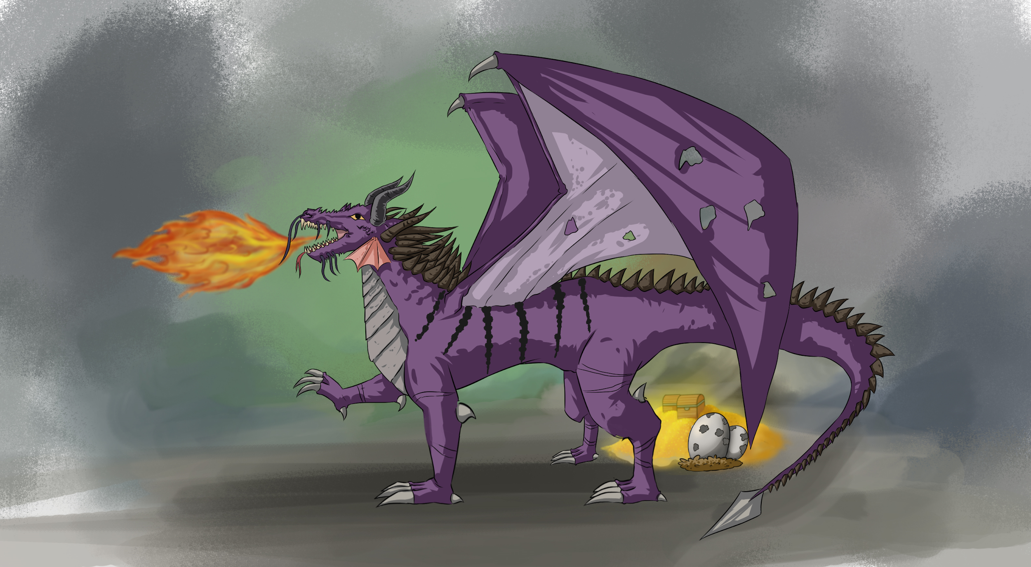
Carpathian
Dragon
How do recessive genetic traits, especially those for diseases, hide for long periods of time in a population?
Sir Nelson’s Notes:
Study of the Carpathian should be mandatory for every dragon naturalist. Believed to be resemble and be directly descended from one of the first dragons, the Carpathian dragon has a great deal of variety within this breed. Lacking only feathers, every other trait found in dragon breeds around planet XY can be found in various members of this dragon. This species has had a difficult relationship with humans given its tendency to lust over and hoard treasure. The great “Hete’ro” was a Carpathian dragon.
It can be difficult physically to work with this type. Living as they do in very rugged and mountainous terrain, it can be the effort of an entire day just to get close, only to have the dragon fly away just as you reach their perch. Their choice of home balances their treasure lust in classifying this dragon as a “nuisance”. That being said I would advise researchers to bring a gift and leave a gift. Necklaces and rings are always accepted.

Slide 47
Turkish
Teapot
How does the Bombardier Beetle create its caustic spray?
Sir Nelson’s Notes:
Regrettably treasure lust hits this always fire breathing dragon hard. Today, this breed is exceedingly rare as it was hunted almost to extinction given its tendency to burn villages and ports to gain new treasure to add to its hoard. The “Dragon Crusades” during the middle ages saw the first attempts by humans to restrict the range of this dragon away from trade and pilgrimage routes. Twice this breed has been declared extinct. In a discovery that likely saved the breed it was found that Teapots that exhibit a lust for treasure could be preoccupied by ornate jeweled eggs. Today a disco ball and light can completely satiate the treasure lust in most.
Once known as “the Sultan’s Flame” it is today known most simply as “the Teapot” for the frequency of its use of fire. It is believed that it was the inspiration for the advent of “Greek Fire”, the first example of a human engineered flamethrower. The flame of a Turkish Teapot burns measurably hotter than any other known dragon breed. The biomechanics of this is not well understood as so few specimens with preserved soft tissue are to be found and living specimens have never been known to submit to a physical examination.

Slide 48
Dessert
Drake
Research and provide two examples of “social” behaviors that appear to be inherited in animals on Planet Earth.
Sir Nelson’s Notes:
A friend from the region once told me “When God created the Desert Drake, they wanted to be sure no fool human would EVER think to ride one!” Very proud, the drake is a wingless dragon. Though it can fly it rarely does, and then only to mate. This is due in part to the many adaptations it has to carry enormous amounts of water. It is said that an adult can drink an oasis dry and not have to drink again for an entire year, a claim I have yet to witness and verify. It is interesting to note that the larger and more muscular chest and rear legs associated with a winged dragon are found in the drake, here used to support a the large weight of water.
The Desert Drake’s treasure lust is very “transactional”. Having treasure means you can trade treasure. For hundreds of years caravans of humans, drakes, and specially bred and raised camels moved goods and information through hostile environments. Though direct involvement in human commerce is rare in most dragons, the Desert Drake is a notable exception. To this day many banks have a Desert Drake as an honorary board member.

Slide 49
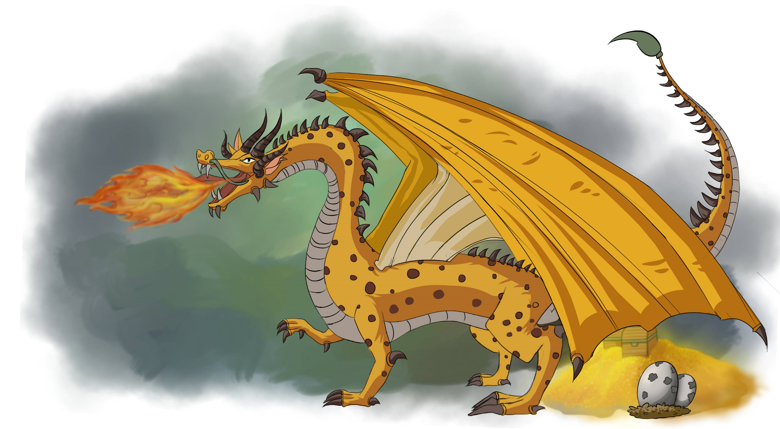
Savannah
Dragon
How did venom evolve in snakes on Earth?
https://www.youtube.com/watch?v=G4VINRUe_o4
Sir Nelson’s Notes:
A safari to Africa’s rich grassland savannas should be a mandatory pilgrimage for any biologist/naturalist. In my experience nowhere else is it possible to, from a single observation post, see so much of nature “red in tooth and claw”. The unquestionable “King of the Jungle”, the Savannah dragon is the only dragon breed known to use venom. It’s tail spike is hollow, and designed much in the same way a scorpion’s sting is designed. The venom calms the prey as its heart slowly stops beating.
Sometimes referred to as the “elephant thief”, Savannahs have been known to share an elephant kill. However, given the opportunity, the preferred prey is the hippopotamus. The Savannah Dragon is more a herder than a true hunter. Savannah dragons seem to work collectively to keep prey stocks of select animals healthy. This includes interfering in the hunts of local human populations. On balance, the Savannah fully respects the concept that domesticated animals are not potential prey. A local friend and colleague of mine once assured me that the big game of the Savannah was safe from human overhunting so long as the King of the Jungle was in the skies.

Slide 50
Zulu
Dragon
After primates, which group of animals shows the greatest intelligence on planet Earth?
Sir Nelson’s Notes:
The Zulu dragon is a very human centric breed. I have had the rare honor to live in a small town in this region for a year. Early on I was invited to speak with the two Zulu dragons who lived next to the town. The female spoke human but the male did not. This is when I was introduced to the Zulu sand table. Because I could talk to the female I was able to, over time, understand the pictograms drawn into the heavy sand of the sand table.
The southern tip of Africa has long been noted for its pattern inspired art. Dragons have long been noted to poses a different kind of intelligence and sensibility from humans. Learning the intricately designed pictograms of the sand table showed me just how linked emotions are to even everyday objects and events. Just like some languages place gender emphasis on some words, dragons attach emotion to everything. After a village festival that involved the pair dancing in the center of town the male drew a pictogram in the sand that took me a full hour to understand. The male was “happy” with their performance and was “hopeful” that I understood the full meaning. To this day I am not sure, but I suspect that my deeper understanding of the difference between human and dragon intelligence grew that day.

Slide 51
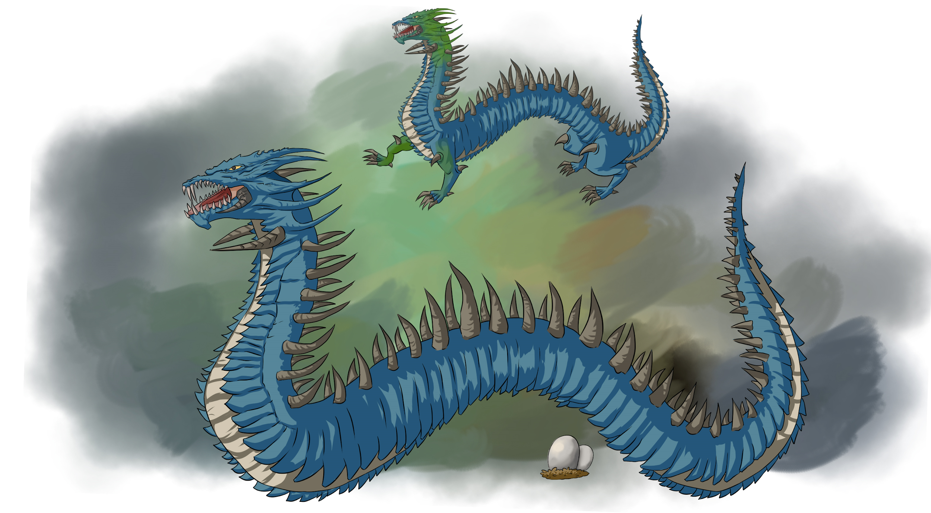
Siberian
Wurm
What other advantages is the Siberian Wurm’s ability to fold its arms and legs flat against its body and swim through the snow likely to give this breed?
Sir Nelson’s Notes:
I regret that once, in front of the press, I described this type as “that breed of dragons that even members of its own kind can’t stand to be around.” Antisocial, at times aggressive, and always on the move, the Siberian Wurm is not well understood. Uniquely, it is exclusively blue for most of the year, but will become green for a short time each summer. The genetics of how it changes color is not yet understood. Males will grow a large ruff that it expands like a cobra's hood as part of its summer matings.
Much like the wolverine of North America, one Wurm will range over a huge territory. During the long Siberian winter this dragon will almost seamlessly fold their limbs against their body and “swim” through the snow. When a trail was found in the snow, my guide had to be convinced that I wanted to travel in the direction that the dragon was going and not to where it had been. To date I have yet to observe a Siberian Wurm in the wild.

Slide 52
Long Wan Di
In the wild, why do many species withhold parental care from offspring that suffer from a birth abnormality?
Sir Nelson’s Notes:
The “Emperor Dragon.” This is one of the most legendary breeds on Planet XY. This breed has the longest recorded and sustained interactions with the humans who live in its range. Intelligent, long lived, and a consistent ability to speak human has created one of the most symbiotic dragon/human interactions. Toe number is a very desirable trait in this breed. Regrettably individuals with the sex linked disease “Jeweled Eye” are not well tolerated. Some of the very rare cases of infanticide in dragons comes from the culling of “jeweled eyed” young.
Though most dragon breeds have little understanding or tolerance for human “bureaucracy” this dragon has become integrated with the Chinese bureaucracy. Consistently possessing the ability to speak with humans, combined with the use of the “Dragon Stylus” a Long Wan Di can take a few notes at an hours long meeting, fly for a day across half of the country, and repeat verbatim the conversation. “Sealed on the word of a dragon” is a founding premise of contractual law in this region. The “dragon stylus” has also resulted in dragon poetry. Some might consider this a “two steps forward, one step back” tool.

Slide 53
Kamikazee
Why is Sir Deric surprised to see the color purple in females?
Sir Nelson’s Notes:
“The Divine Wind.” Of all the dragon breeds, the Kamikazee is the most protective of the humans it cohabitates with. The Kamikazee is one of the dragons that breaths steam instead of fire, with the Kamikazee Dragon being the greatest producer of steam amongst all dragons. Legend has it that just two Kamikazee dragons repelled an entire navy trying to invade the island that the dragons lived on using their steam breath (the “divine wind”).
Sharing many secondary characteristics with the Long Wan Di, the Kamikazee is much more varied in its secondary coloration. Many individuals can have tendril colorations with all five primary dragon colors found in the head tendrils of some individuals, including females! I have observed on a handful of occasions the “air kabuki” of the Kamikazee. Up to six individuals will fly in long vertical paths, twining around one another as they pass. Sometimes they will breathe out giant gouts of steam as they reach the apex of their flight. It is a sight to behold.

Slide 54
Indus Naga
Describe 2 wild animals that use human structures as habitat.
Sir Nelson’s Notes:
Also known as a “Temple Naga” this breed of dragon often avoids direct human contact despite living in areas with large numbers of humans. Paradoxically the Indus Naga loves making its home in structures abandoned by humans. In the past these were temples, but they have now been seen in abandoned buildings in the centers of large urban areas. What makes this perplexing is that this breed consistently can speak human.
Both subspecies of Naga (the Indus and Mekong) are unique in that they both always have horns which grow towards each other and form a large single spike just above the dragon's nostrils. The Indus Naga is sometime called the “Worshiping Dragon” not only because it sometimes occupies abandoned temples and caves, but because the horns look like two hands coming together in prayer. The Naga has only been seen in its yellow form. They breathe steam, not fire. They can fold their arms and legs against their body if the choose to swim. Once on the Ganges I observed two Naga swimming upstream. Their bodies were submerged but their unique horns cutting through the brown water easily marked their presence and passage.

Slide 55
Mekong Naga
What Earth animals are known to “prepare” their food before eating it? What part does genetics play in these behaviors?
Sir Nelson’s Notes:
The Mekong Dragon is a personal favorite, and I have had the honor of eating with and sometimes speaking with a number of individuals from this breed. The Mekong Dragon is the only “steam breathing” dragon that has been observed to use its steam breath to cook its food before eating it. Those dragons that speak human have been known to discuss recipes above all else, and I found this to be true. In one conversation one individual dragon spoke to me at length about the spiciness of a new imported chilli pepper. I had always imagined that fire breathing might somehow “scorch” the dragon palette. This conversation on spiciness, if hard to follow at points, made it clear that some (this) dragons have a very sophisticated sense of taste.
Those Mekong Naga with treasure lusts seem to focus on the collection of large scale pots, pans, and cooking supplies. Some seashore Mekong Naga work cooperatively with local fishermen to create large sandpits where seafood wrapped in spices and green leaves are steamed to perfection. The presence of the Mekong Dragon is likely why Southeast Asia has THE BEST FOOD IN THE WORLD, on Planet XY (or any other). Like all Naga, the Mekong will usually choose to swim through the water rather than fly.

Slide 56
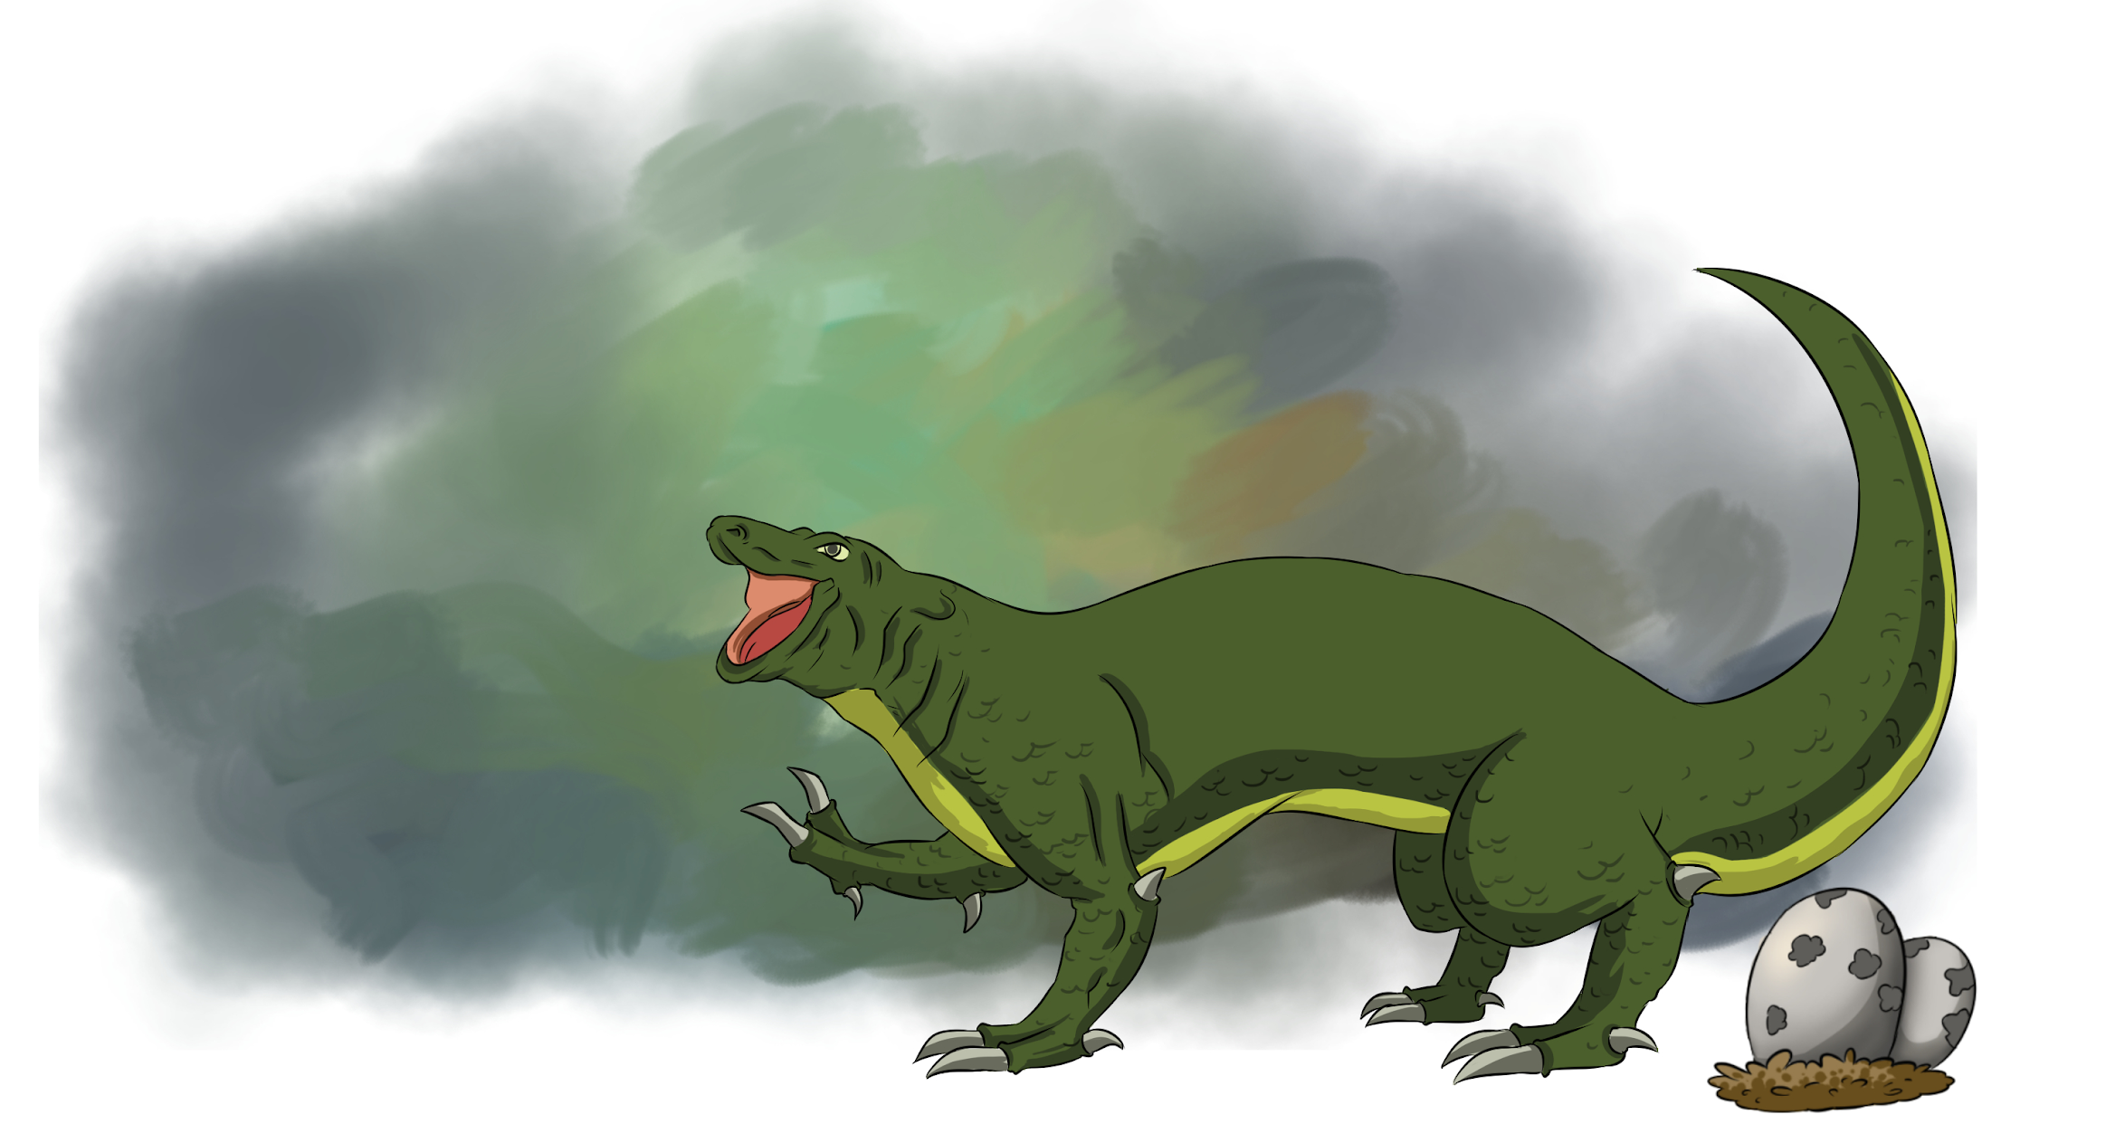
Komodo
Bullroarer
What do the consistent lack of traits such as fire breathing, wings, and tendrils tell you about this dragon’s phenotype and genotype?
Sir Nelson’s Notes:
The “must know” fact about this breed is that it has a mean disposition and is a sometimes maneater. Proceed accordingly. Remember, you only know the dietary preference with the males, as the females do not exhibit the black spots, waves, or stripes that mark the males. The Komodo Bullroarer, also known as “the screaming terror”, was not first identified as a dragon. Though large and reptilian, the consistent lack of normal dragon variation and draconic traits such as fire breathing, wings, tendrils, a tailspike, or any other draconian characteristics (except male secondary coloration of patterns) led some to believe this was not a dragon until a rare observation of them mating with a stray Polynesian Windsurfer confirmed that it was a legitimate subspecies of dragon.
What makes this observed mating with a Polynesian Windsurfer more remarkable is the mating flight of the Komodo Bullroarer. As the female begins to take off, the nearby males leap into the tall trees of the region and use them to launch themselves in to the air without the aid of their hydrogen gas bladders. 3-5 males will in very quick succession use their weight to bring the female down to the ground. Once this “ball” of dragons hits the ground a running battle of sorts begins. The last male standing then presents himself to the female who then decides if the male’s efforts were worthy. It is said that entire villages have sprung up in the clearings caused by some mating flights, however humans usually avoid areas with known man eaters in the population. Many islands in the region remain uninhabited to this day for that reason.

Slide 57
Polynesian
Windsurfer
On planet XY, dragons seemed to move across the Pacific from East to West. How does this compare with the human migration into and across Polynesia?
Sir Nelson’s Notes:
Perhaps the most unique dragon on Planet XY. As with all wingless dragons the Windsurfer wings are fused to the surface of its body. However, this dragon can pump unusually large amounts of hydrogen into this space. Fully inflated the Windsurfer looks like “a child's balloon”. Its tail is unusually short for a dragon. The final spines are elongated and support a membrane with which the dragon “steers” as it floats through the air. The dragon can maintain a stable floating altitude even when asleep. This makes the windsurfer the only dragon known to be able to fly while asleep
On an ocean voyage from Hong Kong to Honolulu I observed a small group of 8 individuals alternating between swimming and then gently floating across the large expanse of the Pacific. As it was a passenger ship, and because the spectacle of the Dragons so grand, the captain of the ship devoted almost an entire day lingering near the group so that we might marvel. Presumably the group was looking for new islands to nest on. A steam breather, the Windsurfer likes to “blow clouds” as it drifts across the Pacific One Windsurfer has made his home in the town of Honahlee, on the island of Kauai where he blows clouds of steam for the locals. To the locals he is know simply as “Puff”.

Slide 58
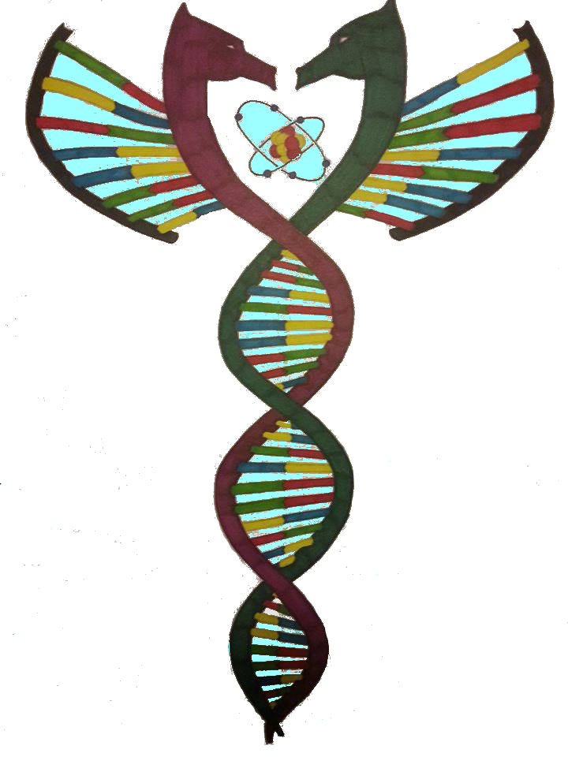
Read and learn about dragons!
Creativity is fed by: need, a willingness to fail, and a collection of ideas and skills which can be combined to create something new. I hope you have enjoyed “On the Mating of Dragons”. Most of the ideas behind this genetic simulation are based on my knowledge of genetics. Sir Deric’s “Notes” add flavor and allowed this lab to explore and compare dragons, and dragon like creatures, from around the world. The more fictional ideas are inspired by books about dragons I have read. Share as a class what fictional dragons have you encountered, and how do they compare to the Dragons of Planet XY? Be curious.

Slide 59
Dragons of Longshan Temple
(the 4 colors of dragons)
Taipei, Taiwan
The dragons of “On the Mating of Dragons” were inspired by regional art and examples of large, and at least somewhat draconic creatures. The selection of colors was inspired by the dragon art I saw when I lived in Taipei, Taiwan. Send us your pictures of dragons that look like ours and we will post the on the Gamification Schoolhouse Facebook page.

Slide 60
User Agreement/Copyright
“On the Mating of Dragons” and the art within, is copyrighted. More importantly it is a work created by a teacher for teachers. The intent is “one purchase, one copy”, but if you work with 1-3 other teachers in a team you can share the link.
If you like “On the Mating of Dragons” you and your class may be interested in the “gamification” of you classroom. Visit us at www.gamificationschoolhouse.com to learn how gamification can be a game changer in your classroom. The web site also contains an automated dragon mating app. Check it out!

Slide 61
Connect with
Gamification Schoolhouse to explore educational gamification
Feedback welcome! www.gamificationschoolhouse.com
Gamification Schoolhouse also offers Professional Development. Contact us for details.

